Slide 1
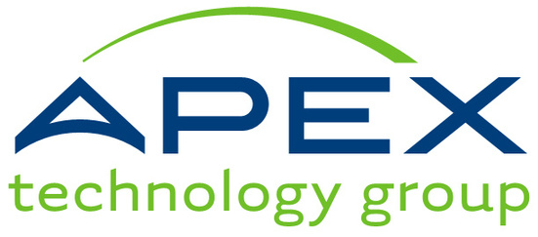

THE APEX TECHNOLOGY GROUP, INC.
May 14, 2024
CT COST - CYBERSECURITY SERVICES BRIEFING
PRESENTED BY:
COREY MCQUADE
DIRECTOR OF ENGINEERING
THE APEX TECHNOLOGY GROUP, INC.
CMCQUADE@APEXTECHGROUP.COM

Slide 2

Background:
The Apex Technology Group, Inc. has been at the forefront of technology solutions catering specifically to the public sector for 25 years. With a large focus on K-12 educational institutions and municipal government entities, Apex has established itself as a trusted advisor to many across the CT/RI/MA region. Offering expertise in technology strategy and support, Apex has consistently delivered innovative solutions tailored to the unique needs of its clients. Through strategic partnerships and a commitment to excellence, Apex continues to empower schools and local governments with innovative technology solutions fostering digital transformation
Services:
•Technology & Cybersecurity Strategy
•Procurement
•Project Management
•Professional Services
•On-site and Remote Support
Apex OveRVIEW
ESTABLISHED 1998
Apex is headquartered in Cranston, Rhode Island with offices in Connecticut & Massachusetts.
The Apex Technology Group, Inc. | Apex Overview

Slide 3
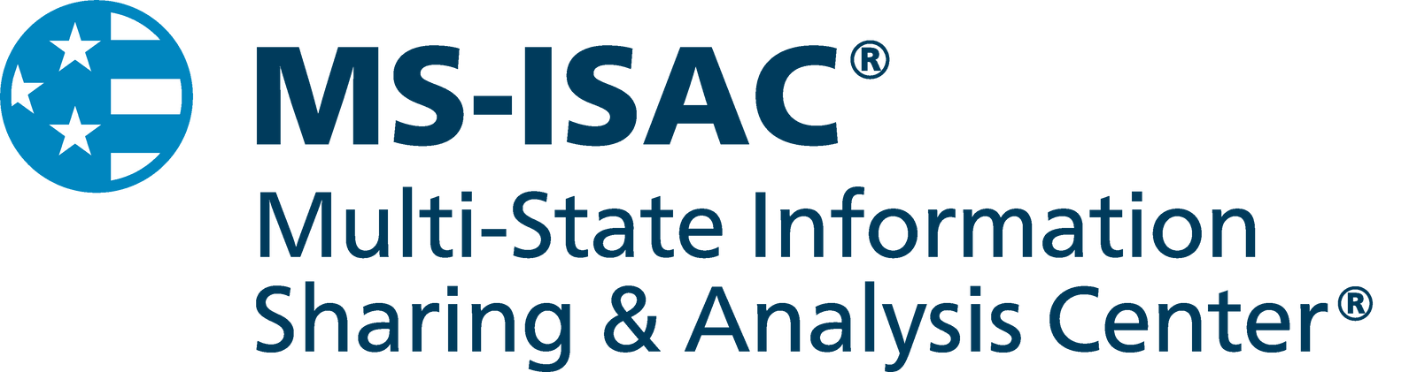
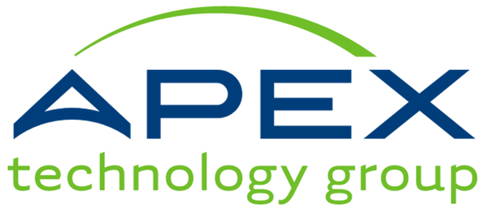
Membership
No-Cost Services
  Share information amongst all members, enhancing visibility.
  Open to all US State, Local, Tribal, and Territorial government organizations
  Security Operations Center (SOC)
  Malicious Domain Blocking and Reporting (MDBR)
  Cyber Incident Response Team (CIRT)
  Cybersecurity Advisories
  Cyber Threat Intelligence (CTI)
  Nationwide Cybersecurity Review (NCSR)
  CIS SecureSuite Membership

Slide 4
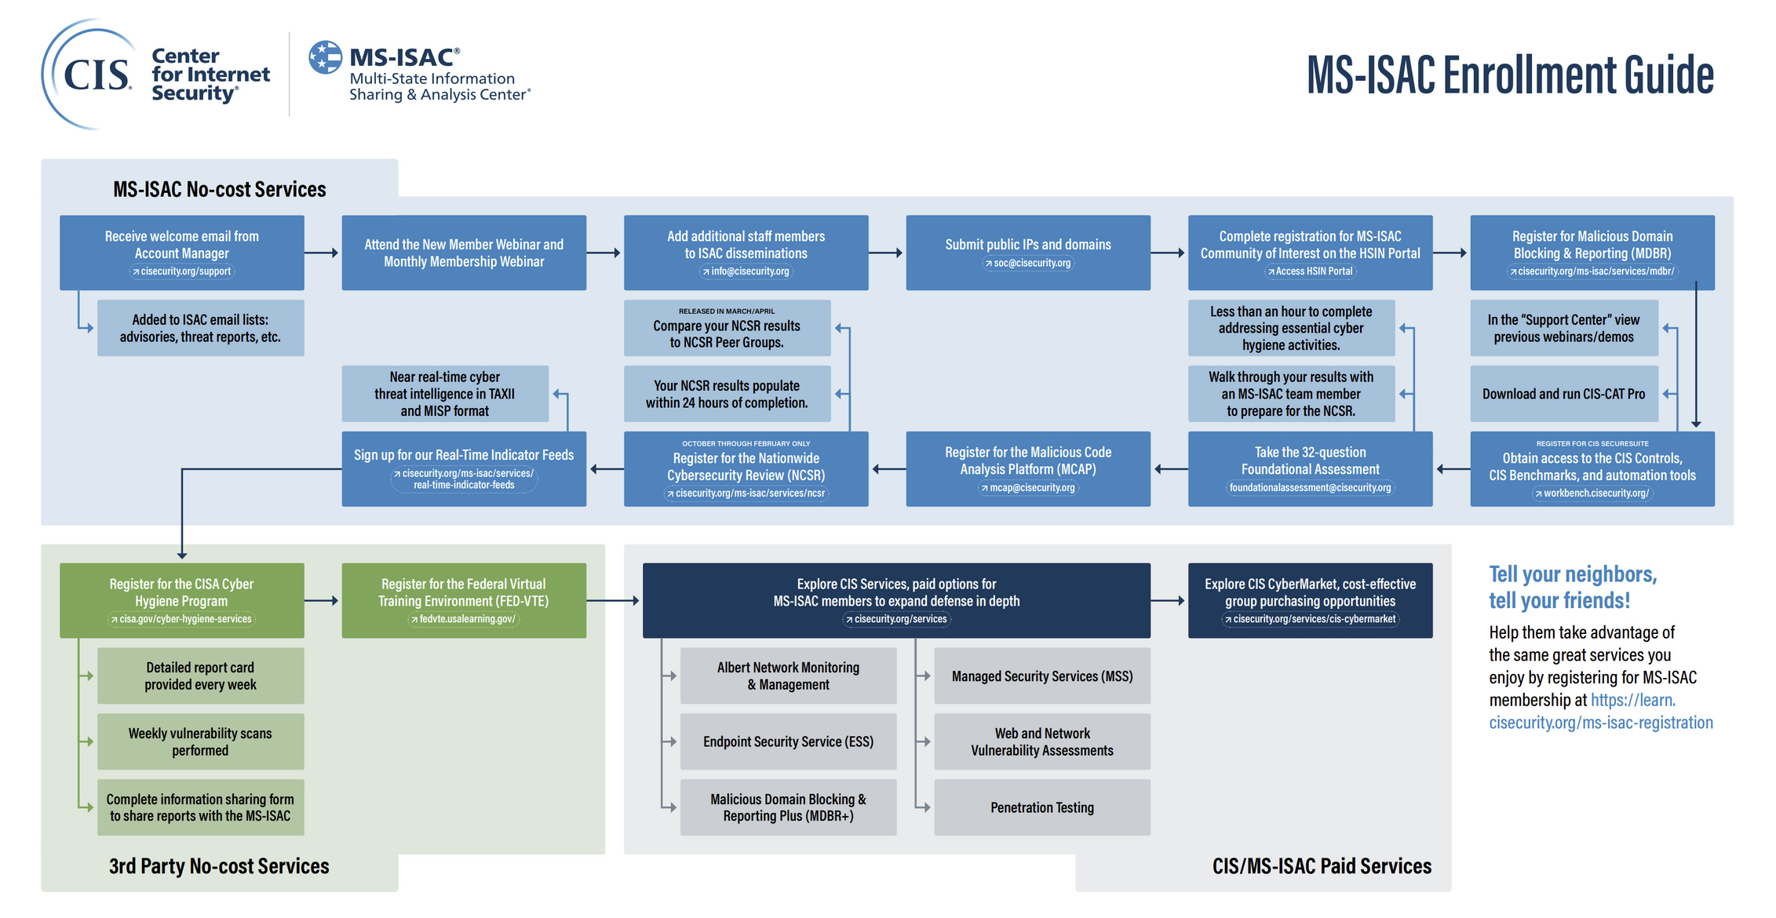


Slide 5

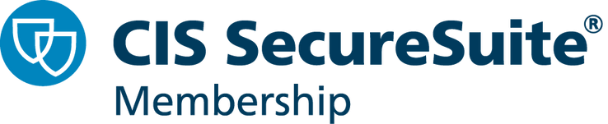
No-Cost Services
  CIS-CAT Pro
    Configuration assessment tool tracking conformance to CIS benchmarks.
  CIS-CSAT
    On-premises CIS Controls self-assessment tool to help track and assess the implementation of CIS recommended controls.
  CIS Build Kits
    Allow rapid implementation of the recommended CIS Benchmark configurations.
  CIS WorkBench
    Tailor recommended CIS Benchmark configurations to fit your organization
WHO IS CIS?
CIS IS AN INDEPENDENT, NONPROFIT ORGANIZATION WITH A MISSION TO CREATE CONFIDENCE IN THE CONNECTED WORLD.

Slide 6
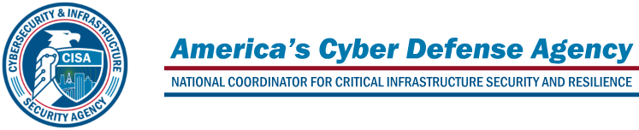



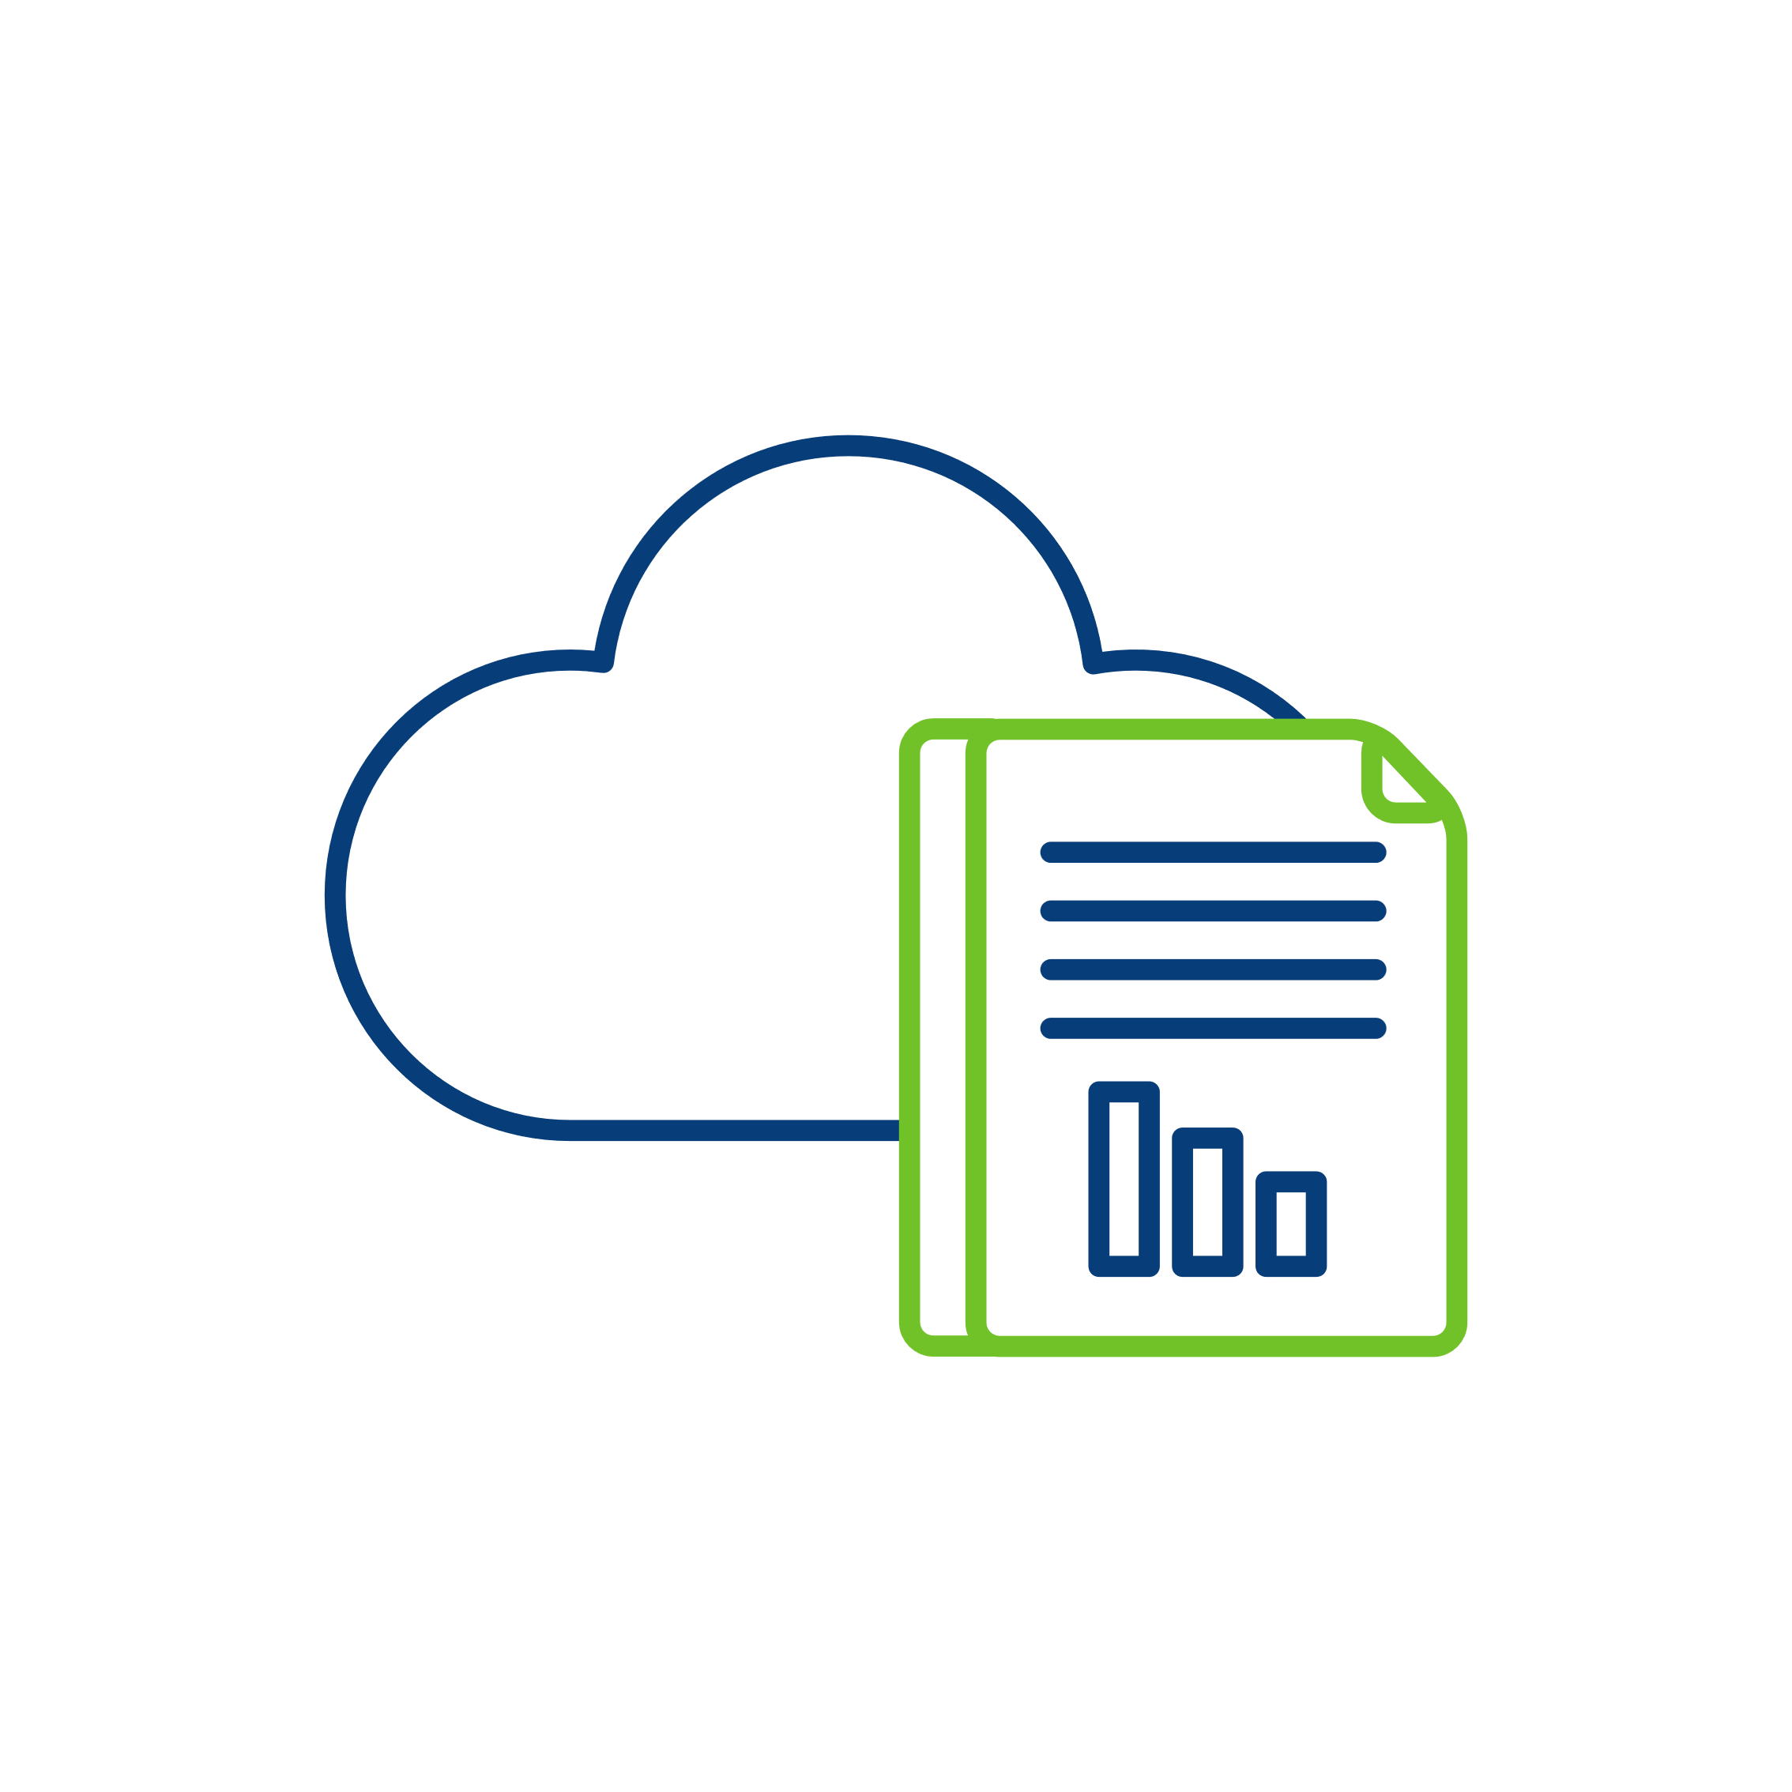




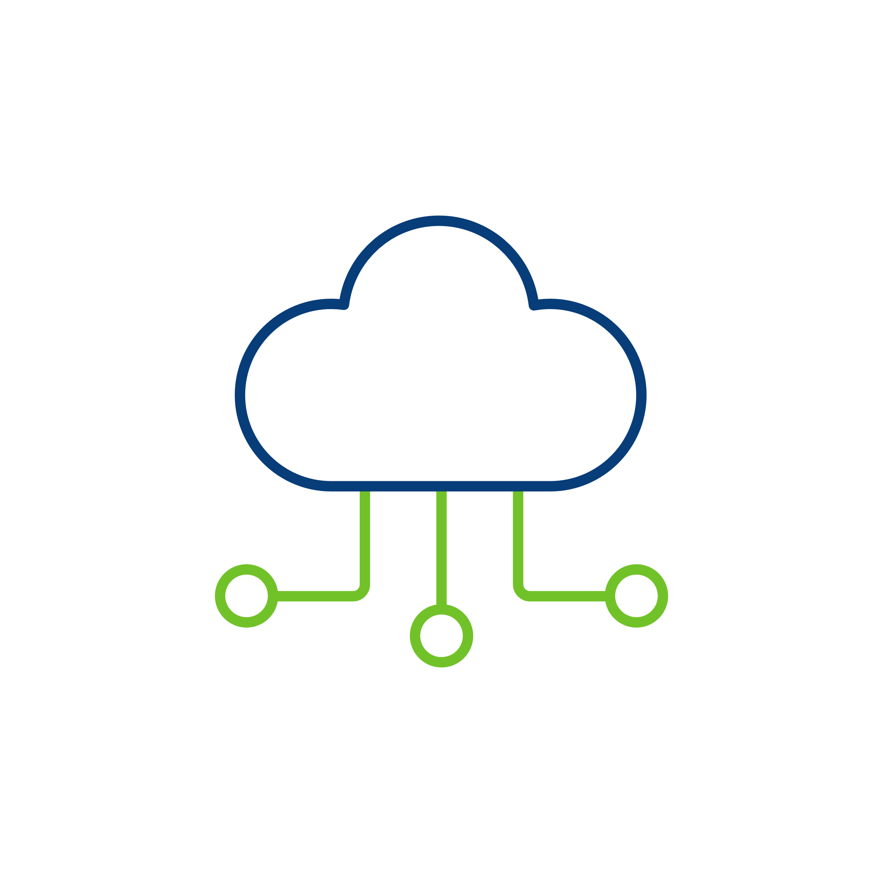
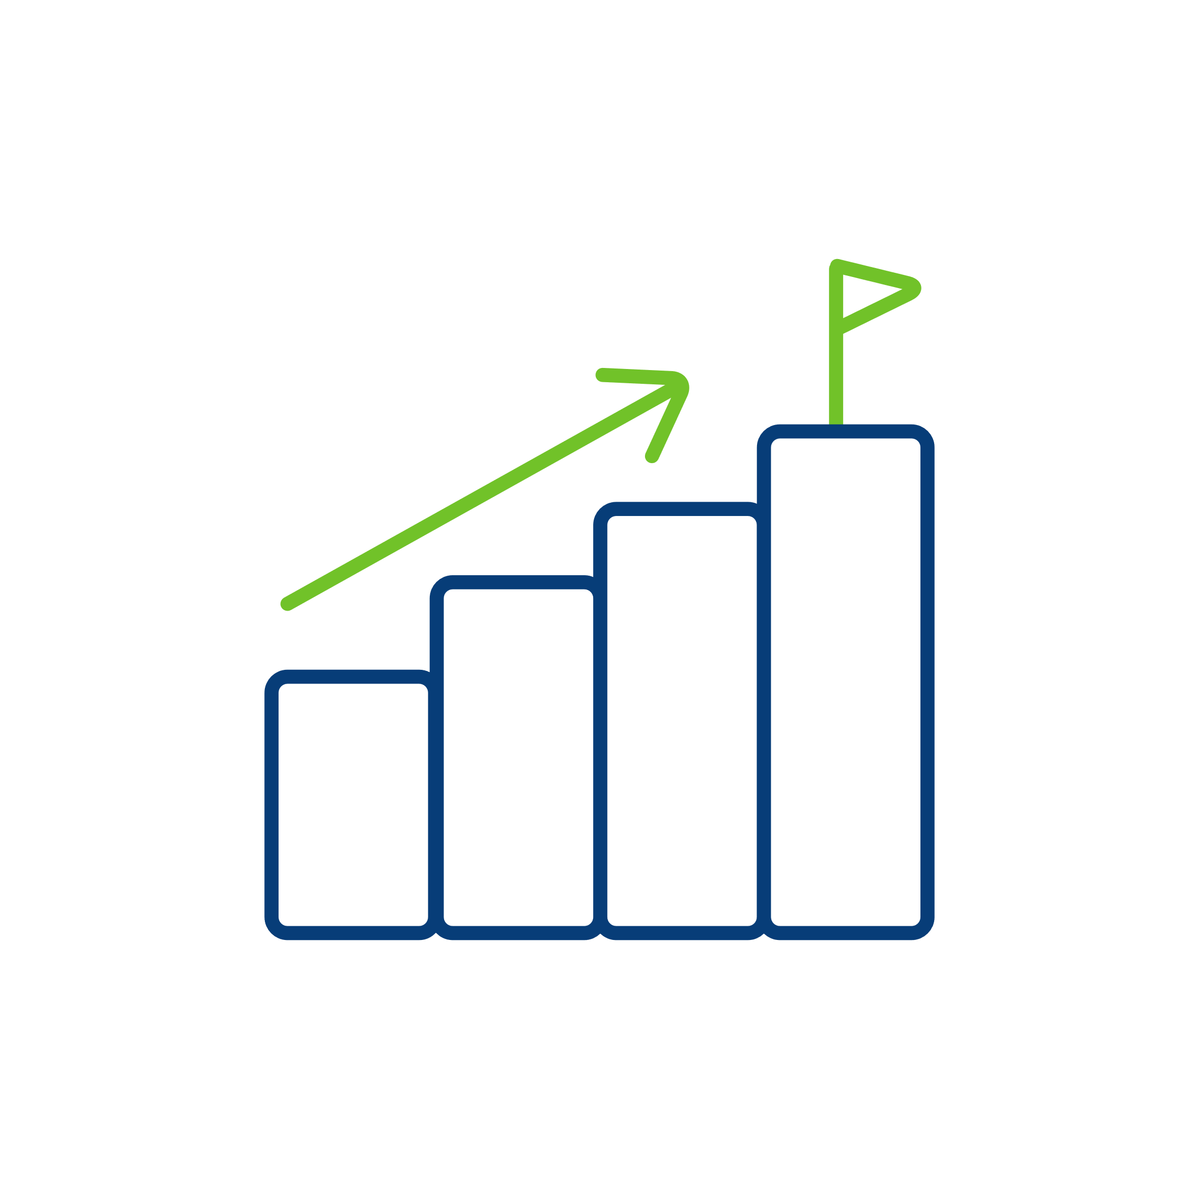







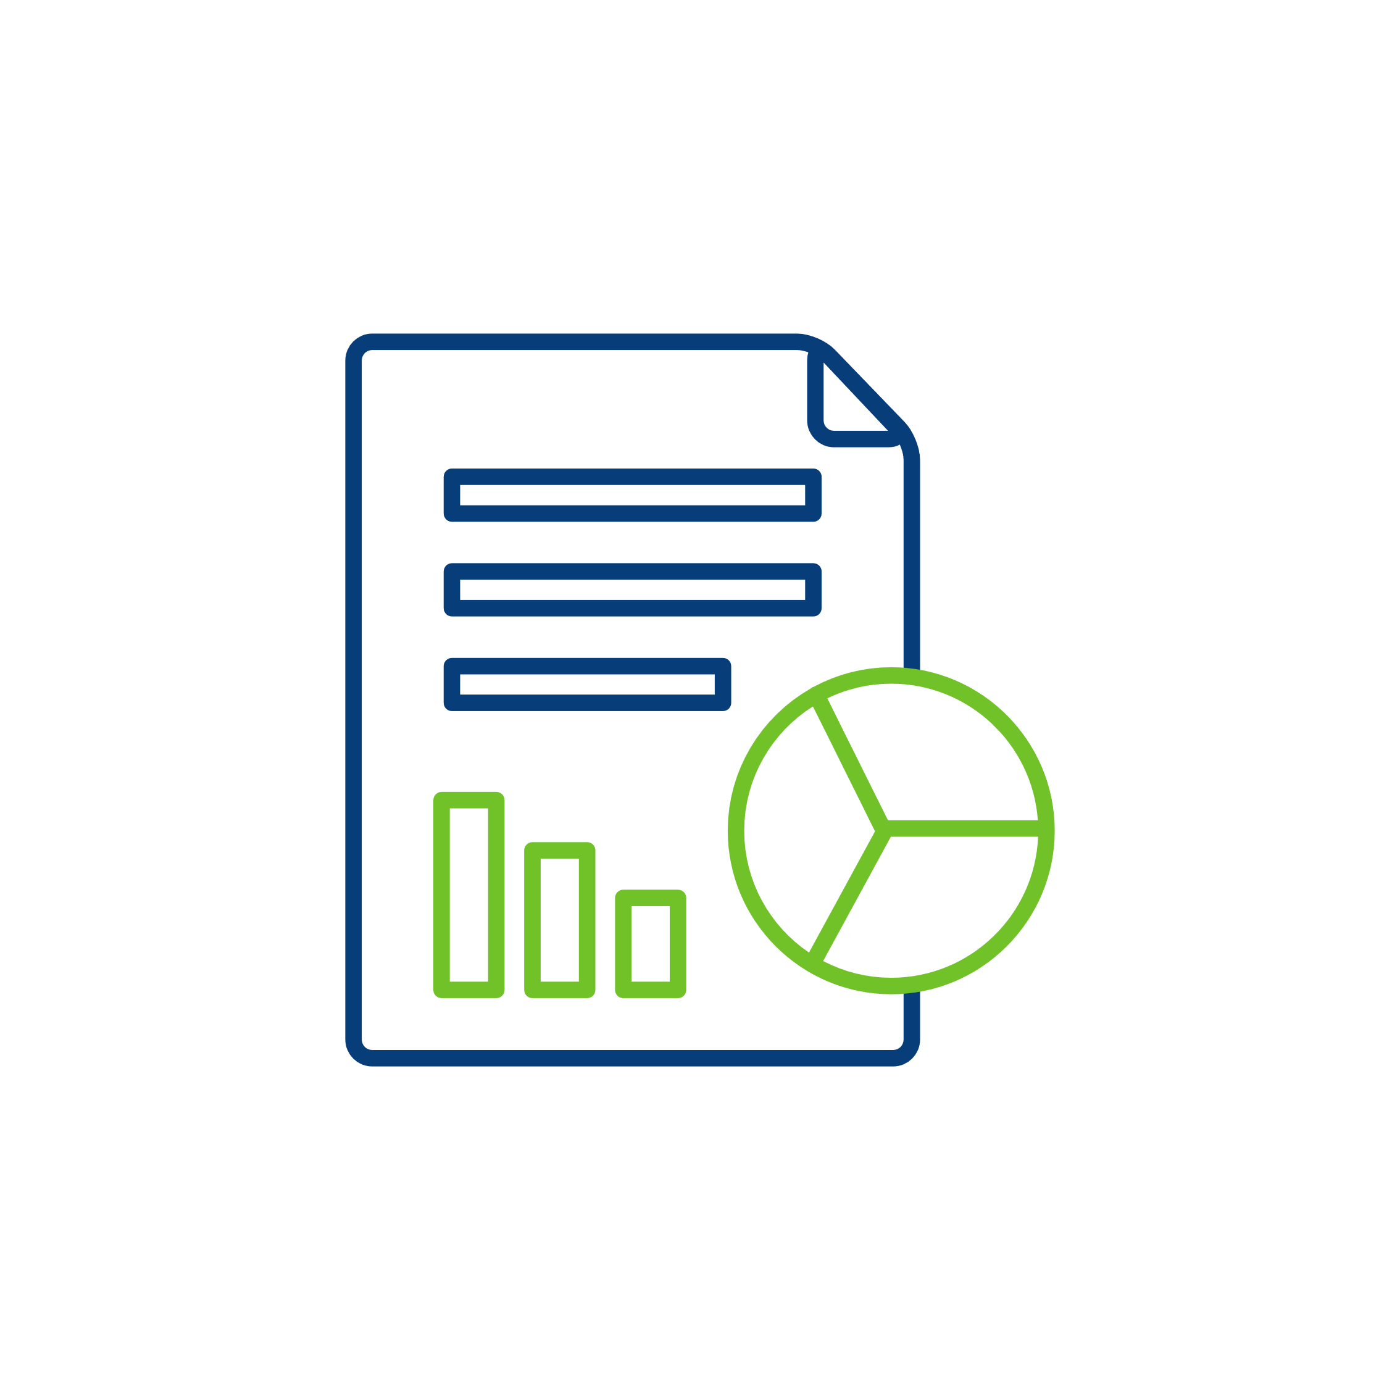


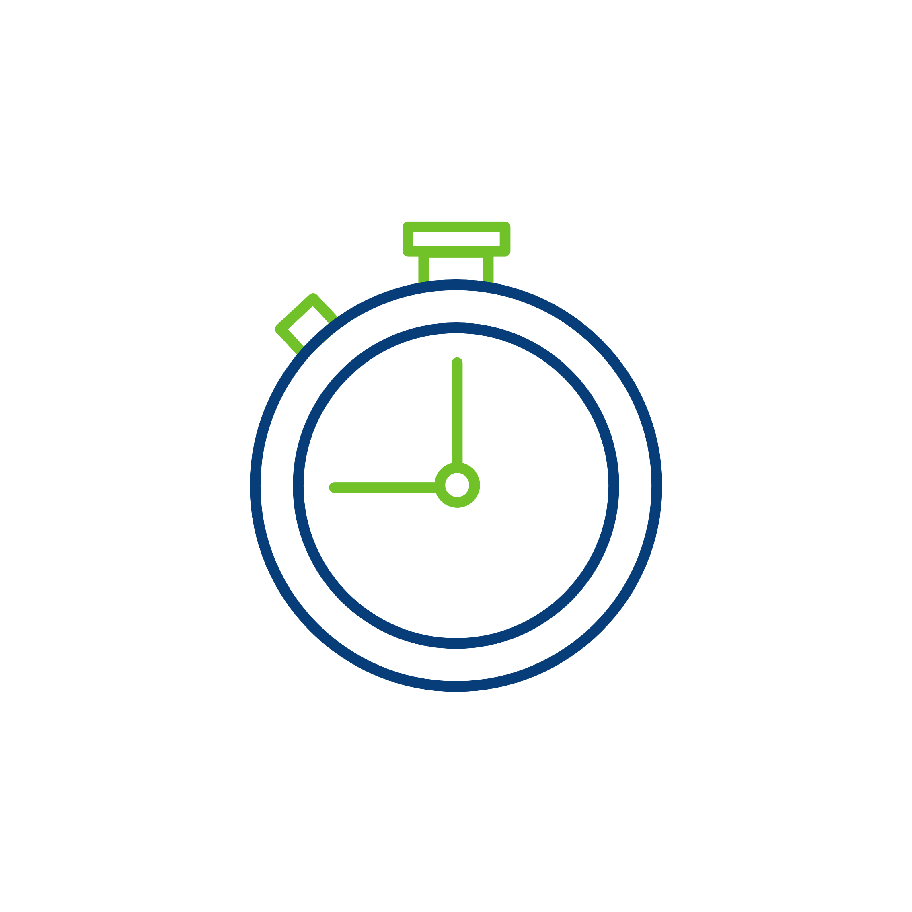


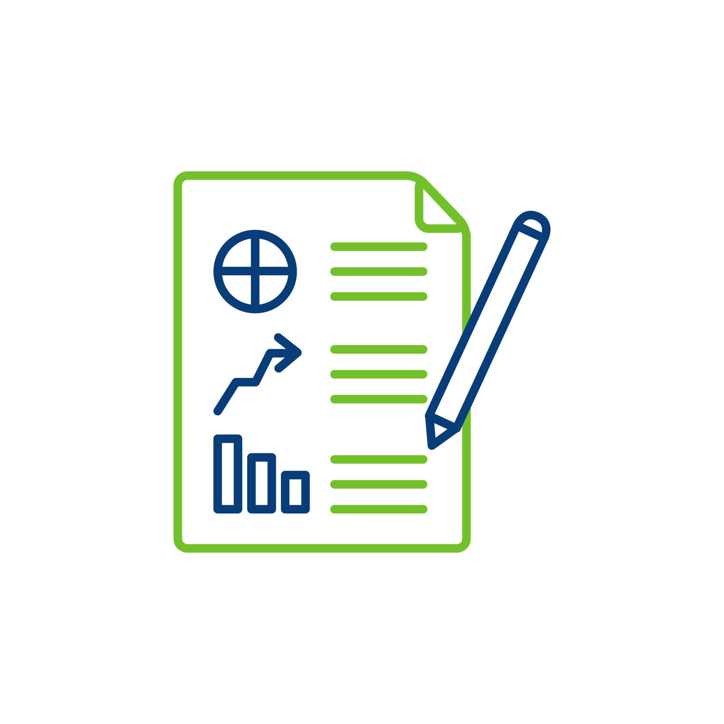
David Palmbach
Cyber Security Advisor (CSA) for Connecticut (Region 1)
Cell: (202) 297-0290
Email: david.palmbach@cisa.dhs.gov
No-Cost Services
  Cyber Performance Goals (GPG)
    Cybersecurity maturity assessment
  Cyber Incident Response, Planning, and Testing
    Aid in responding to cybersecurity incidents, planning documentation, and tabletop testing of your plan.
  Cyber Hygiene Scanning
    Scan for vulnerabilities in your infrastructure to mitigate threats before bad actors exploit them.
  And more...

Slide 7
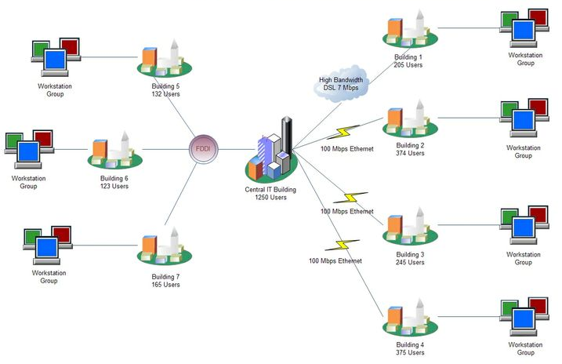
SHARED SERVICES
Cost Efficiency
COST is always a factor. Shared IT Services promotes convergence of systems and resources allowing for economies of scale, saving costs for all entities involved.
Streamlined Operations
A shared IT services approach can streamline operations by eliminating redundant processes and systems. Greater efficiency across resources produces more consistent service delivery to community.
Enhanced Security
A unified approach to preserving the confidentiality, integrity, and availability of data ensures effective security implementation, monitoring and mitigation of cyber threats
Cohesive Collaboration
Integrated software platforms increase collaborative abilities between all entities.
Specialized Resources
Pooling IT resources allows for access to a broader range of resources with focused expertise and technical skills.

Slide 8
THANK YOU
QUESTIONS?
Contact me:
Corey McQuade
Director of Engineering
cmcquade@apextechgroup.com
Contact Heather:
Heather Mosca
Sales Manager, CT & RI
hmosca@apextechgroup.com

