Slide 1


Climate Resiliency Update for Towns
1. Resources and Tools
2. Public Act 25-33
October 22, 2025
David Murphy, PE, CFM

Slide 2
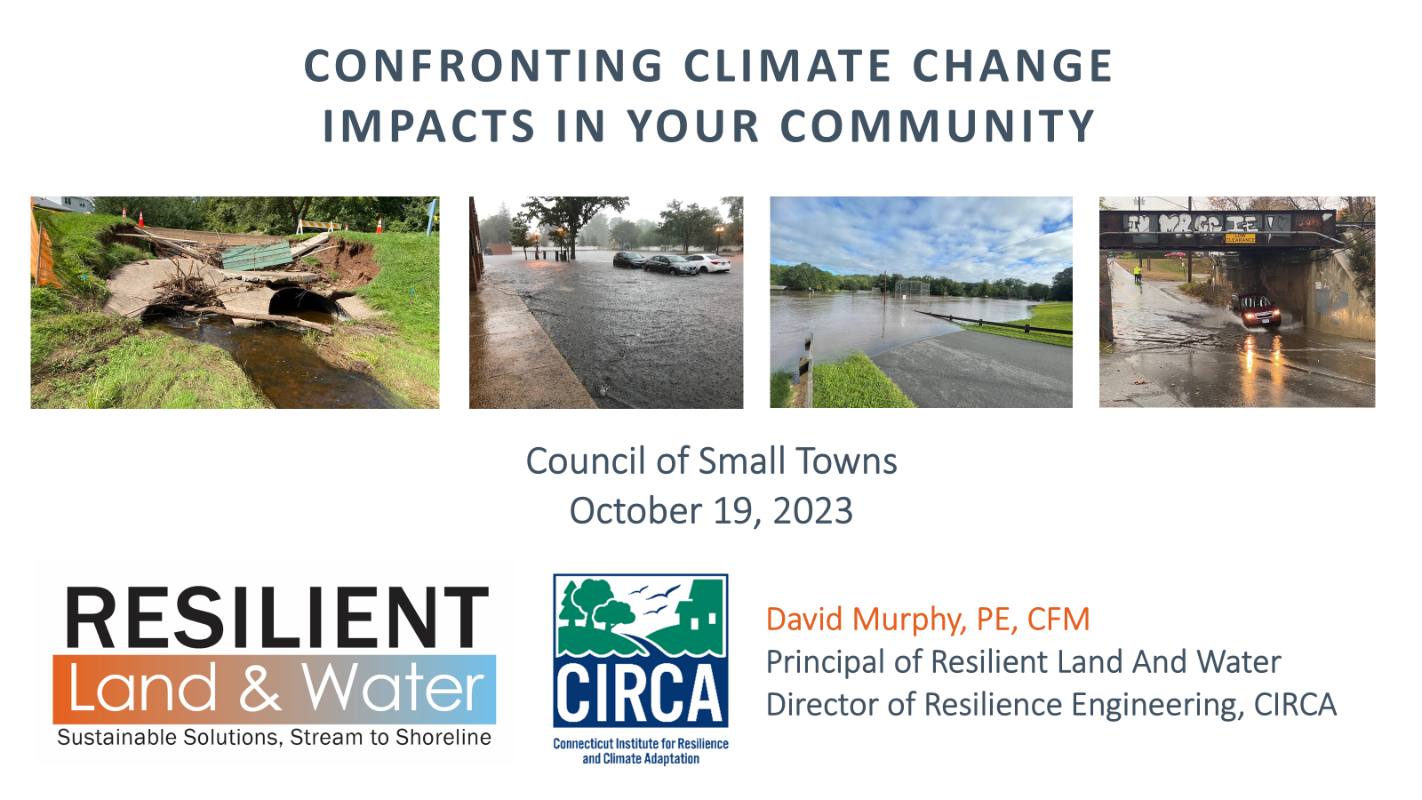
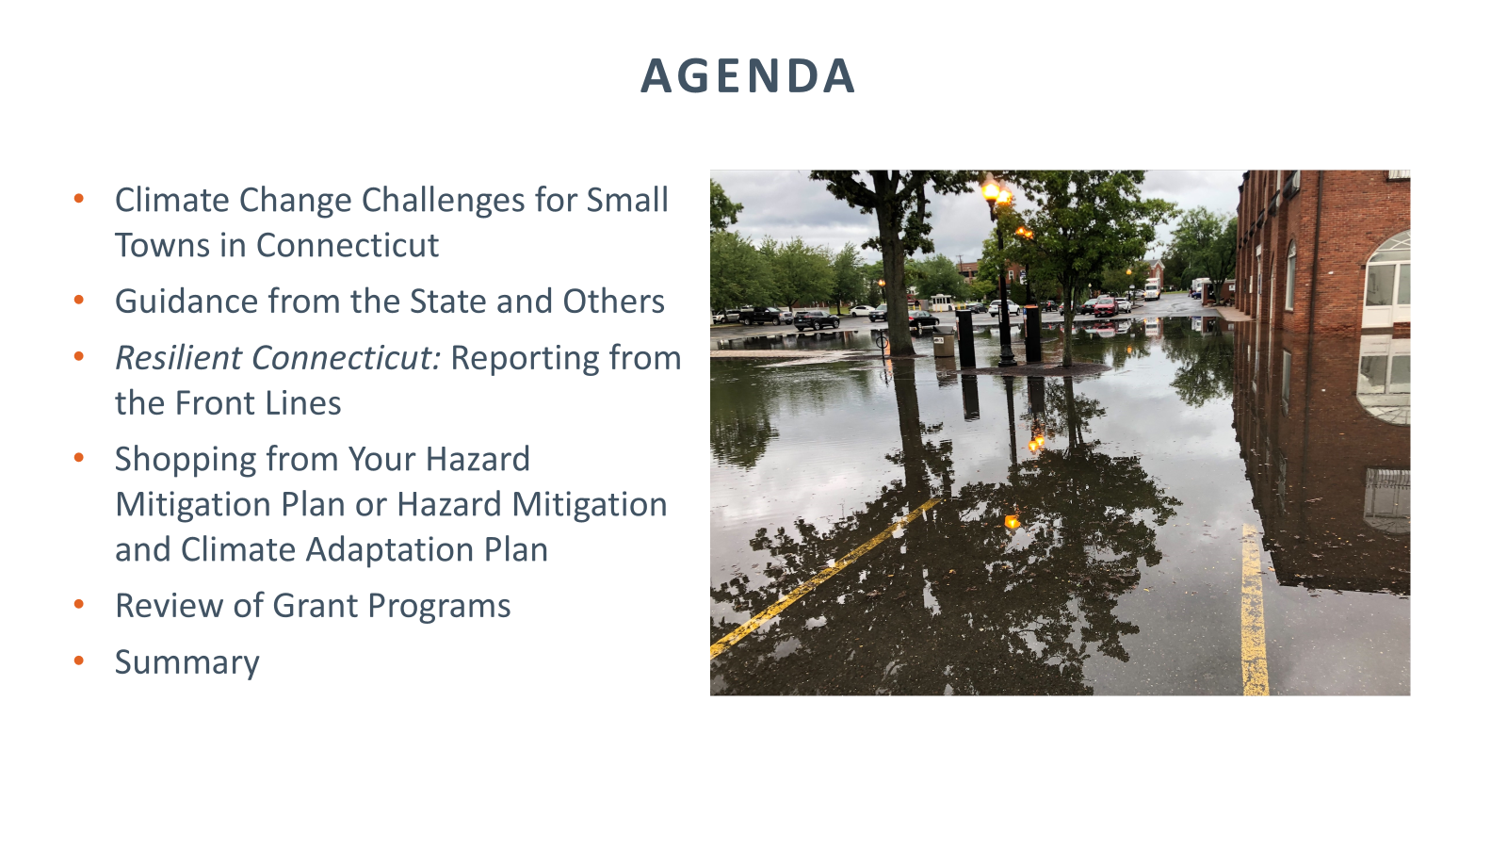
Today’s discussion builds on the climate challenges presentation of October 2023

Slide 3
Agenda Item #1. Resources and Tools
Agenda Item #2. Public Act 25-33
1
2
National Resources
Update of the Connecticut Climate Report
State Resources and Tools
Examples of How to Use Resources and Tools
What’s Next in Connecticut?
New Concepts
Hazard Mitigation Plans
Plans of Conservation and Development
Early Implementation Examples (POCDs)
What’s Next for Small Towns?

Slide 4
Agenda Item #1. Resources and Tools
National Resources
Update of the Connecticut Climate Report
State Resources and Tools
Examples of How to Use Resources and Tools
What’s Next in Connecticut?

Slide 5
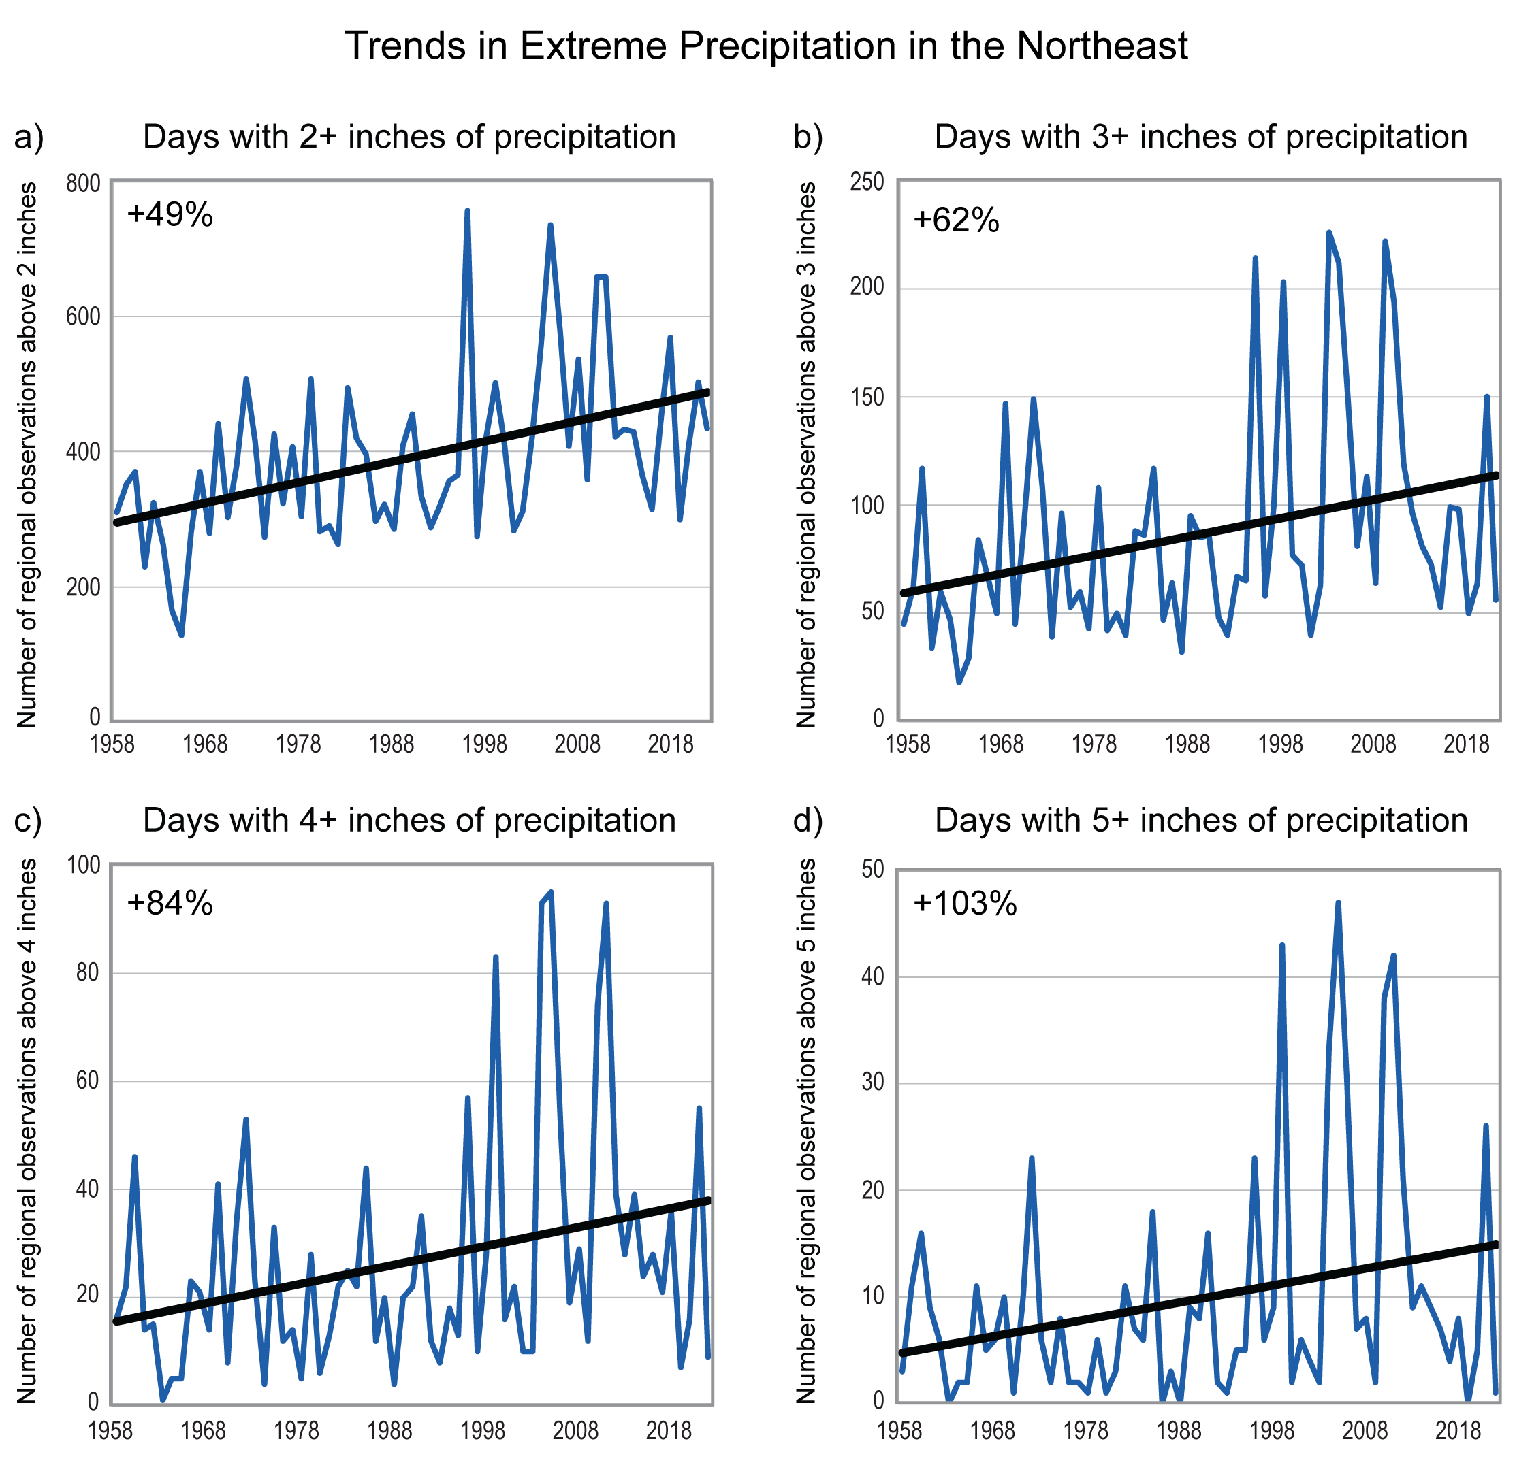
National Resources
4th National Climate Assessment (2018)
5th National Climate Assessment (2023)
4th and 5th National Climate Assessments
NOAA
FEMA
Dominant trend in precipitation in the Northeast has been towards increases in rainfall intensity, with increases in intensity exceeding those in other regions.
Further increases in rainfall intensity are expected, with increases in precipitation expected during the winter and spring with little change in the summer.
Monthly precipitation in the Northeast is projected to be about 1 inch greater for December through April by the end of the century...

Slide 6
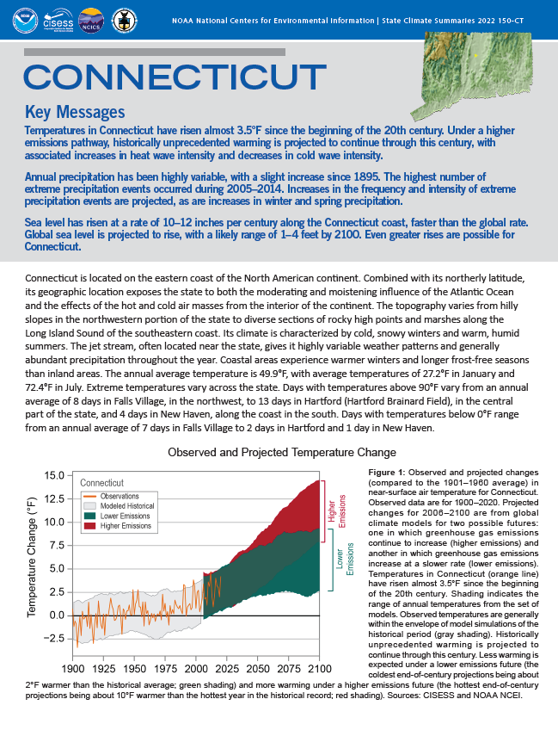
National Resources
4th and 5th National Climate Assessments
NOAA
FEMA
NCEI State Climate
Summaries (2022)
Annual precipitation has been highly variable, with a slight increase since 1895.
Increases in the frequency and intensity of extreme precipitation events are projected, as are increases in winter and spring precipitation.
Increases in total precipitation and in the number of extreme precipitation events may increase inland flooding risks.
Now hosted at https://statesummaries.ncics.org/

Slide 7
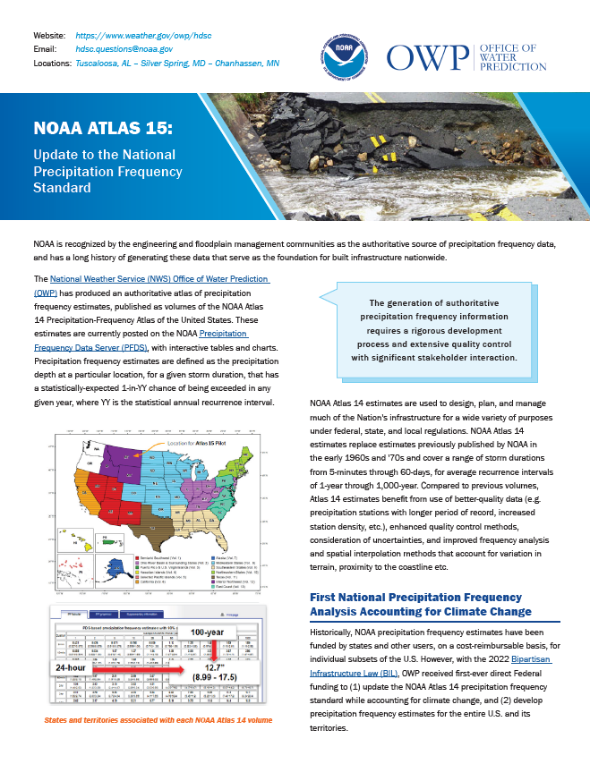
National Resources
4th and 5th National Climate Assessments
NOAA
FEMA
Atlas 14 and Atlas 15
With the 2022 Bipartisan Infrastructure Law, OWP received Federal funding to (1) update the NOAA Atlas 14 precipitation frequency standard while accounting for climate change, and (2) develop precipitation frequency estimates for the entire U.S. and its territories.
Volume 1 will account for temporal trends in historical observations
Volume 2 will use future climate model projections to generate adjustment factors for Volume 1
Atlas 15 was canceled and has been quietly un-canceled.
Look here for more: https://water.noaa.gov/about/atlas15

Slide 8

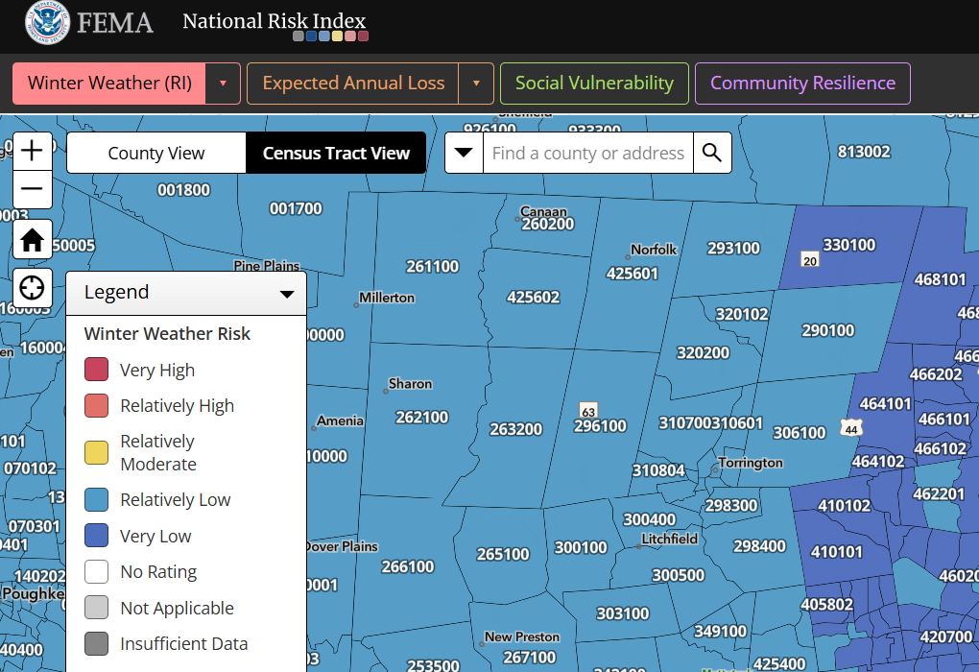
National Resources
4th and 5th National Climate Assessments
NOAA
FEMA

Slide 9
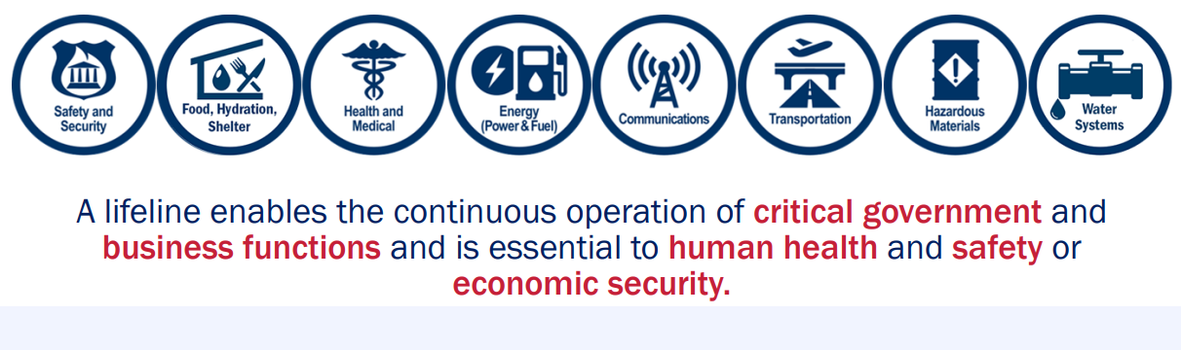
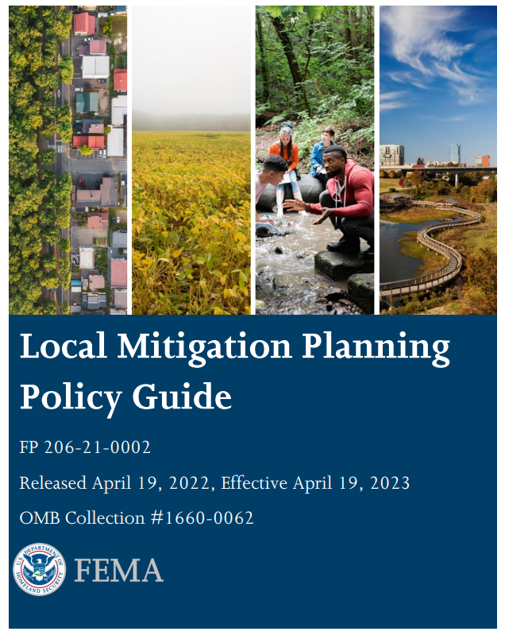
National Resources
4th and 5th National Climate Assessments
NOAA
FEMA
DEMHS is supporting HMGP NOW.
FEMA BRIC was canceled but something will take its place.
If your town is in the RiverCOG or WestCOG region, your hazard mitigation plan update is underway.
STAY INVOLVED.

Slide 10
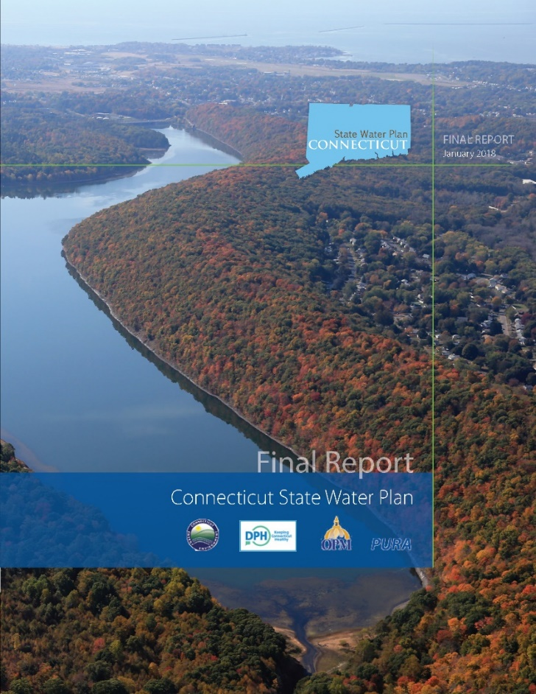
State Resources
Connecticut State Water Plan (2018)
The Connecticut State Water Plan included a climate change analysis.
Four scenarios were the focus of the analysis: "warm/dry," "warm/wet," "hot/dry," and "hot/wet.”
Precipitation projections are variable although consistently project a wetter future for all four scenarios.
The largest precipitation increases are projected for the wetter months (higher percentiles) including extreme wet months.
The seasonality plots in the plan show that winter and spring precipitation changes are projected to be larger than summer and autumn changes.

Slide 11
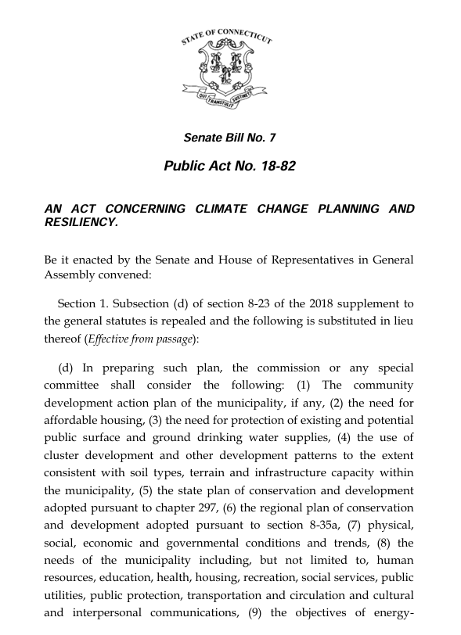
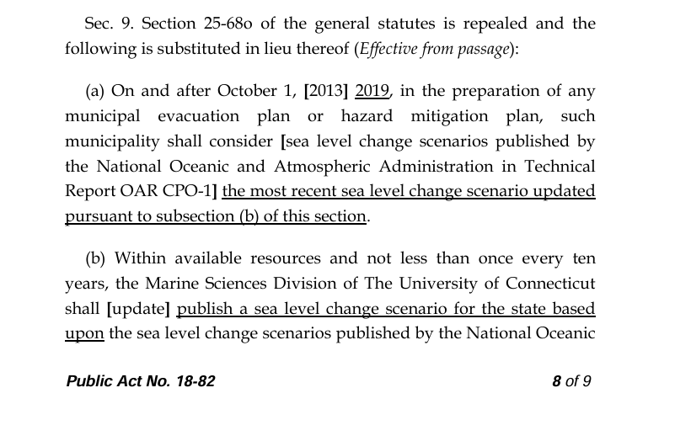
Update of the Connecticut Climate Report

Slide 12
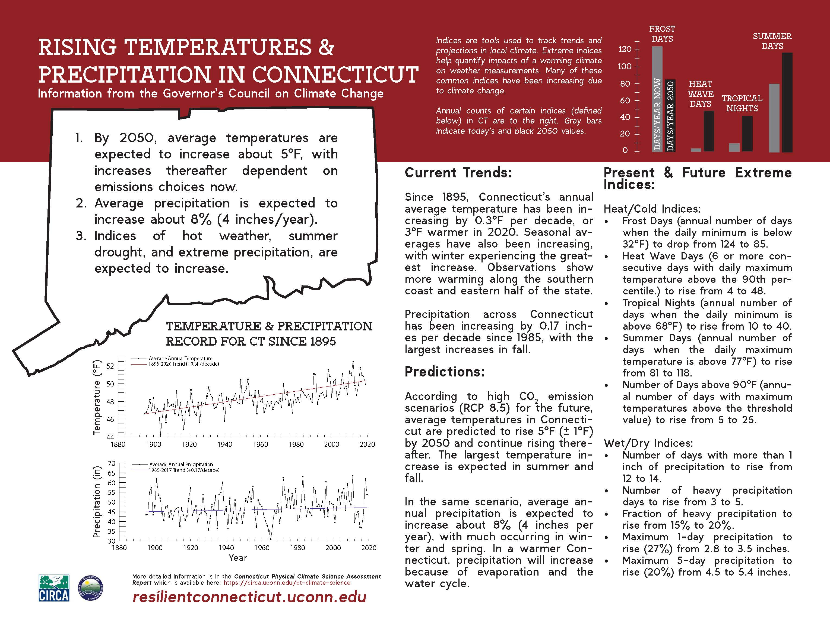
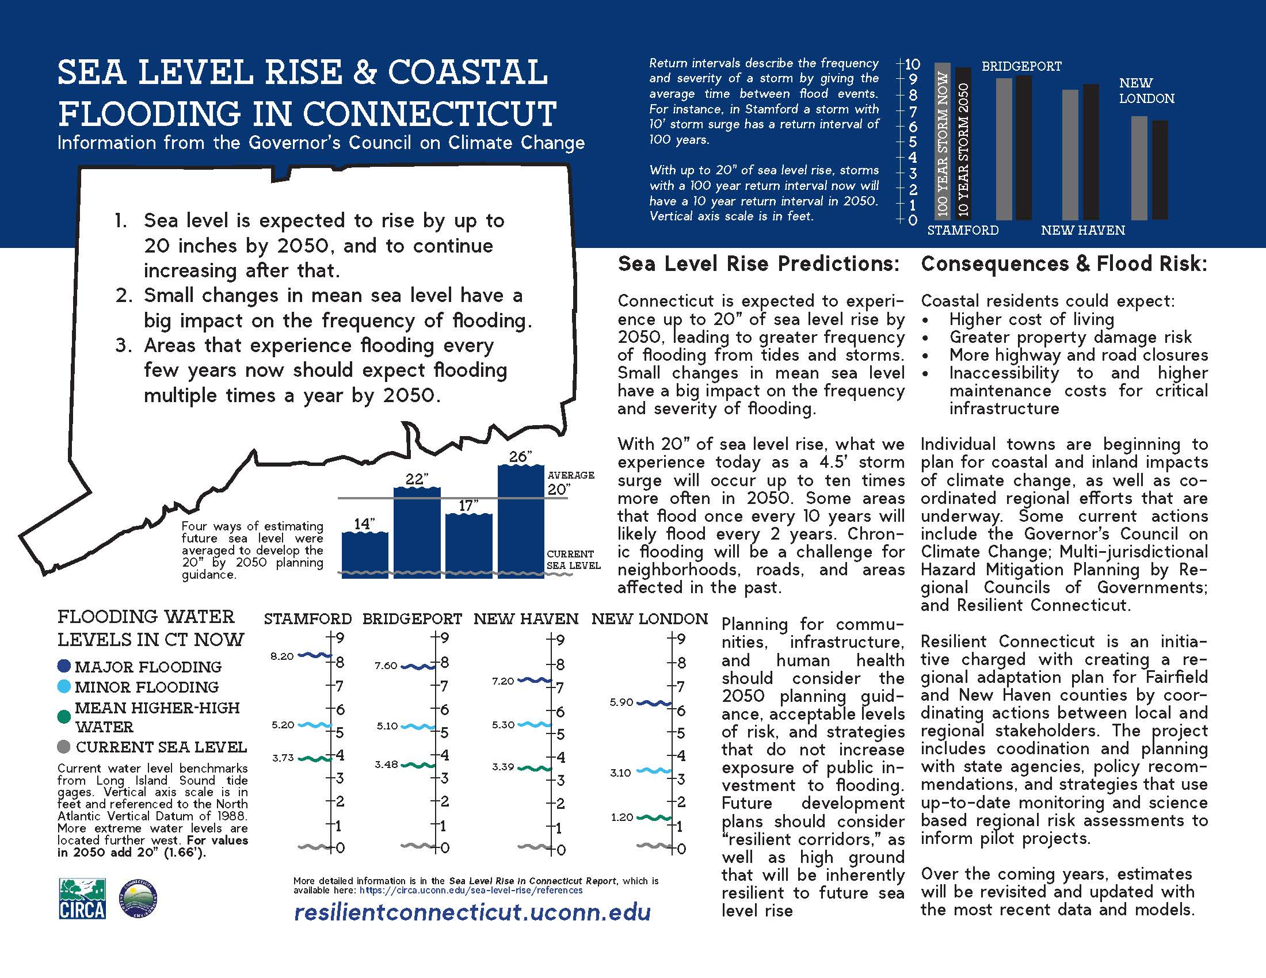
Update of the Connecticut Climate Report
Summary infographics from the 2019 Connecticut Physical Climate Science Report (UConn)

Slide 13
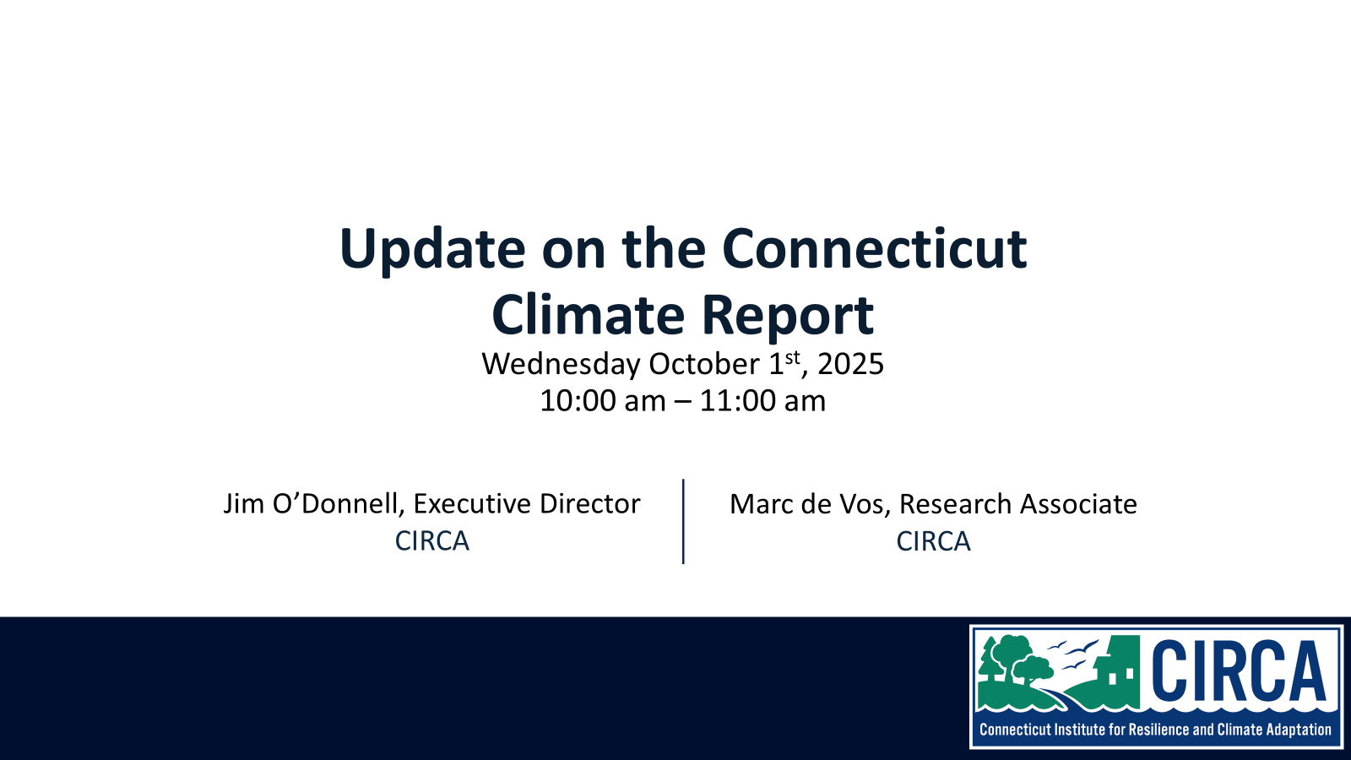
Update of the Connecticut Climate Report
The Update is here!
It focuses on:
Extreme Heat
Precipitation
Sea Level Rise

Slide 14
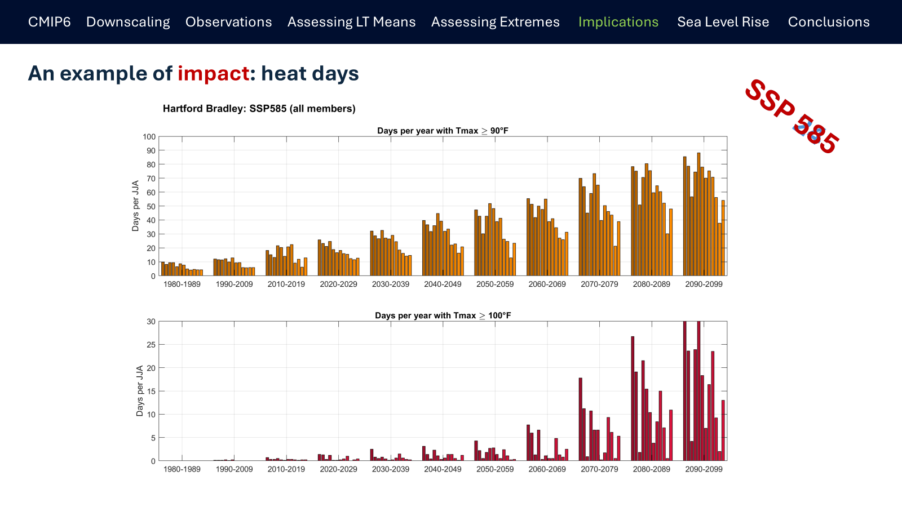

Update of the Connecticut Climate Report
Extreme Heat
Precipitation
Sea Level Rise

Slide 15
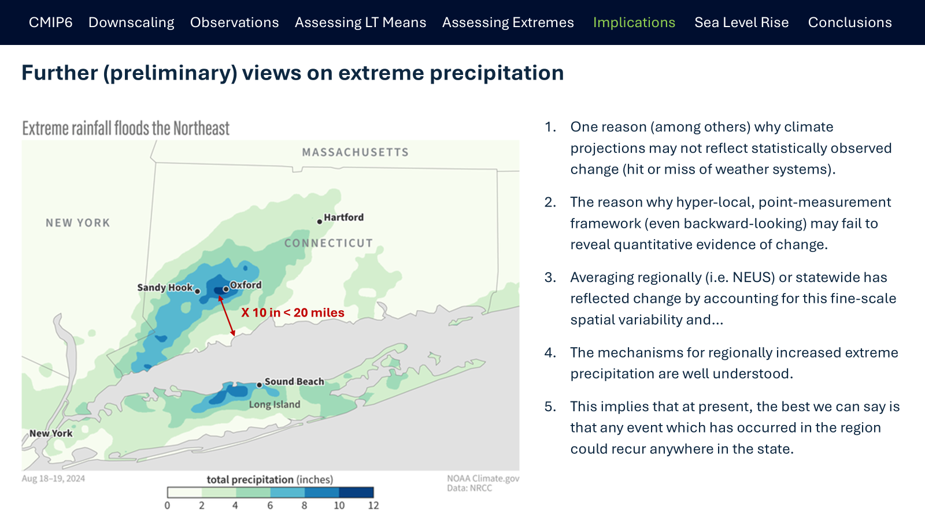
Update of the Connecticut Climate Report
Extreme Heat
Precipitation
Sea Level Rise

Slide 16
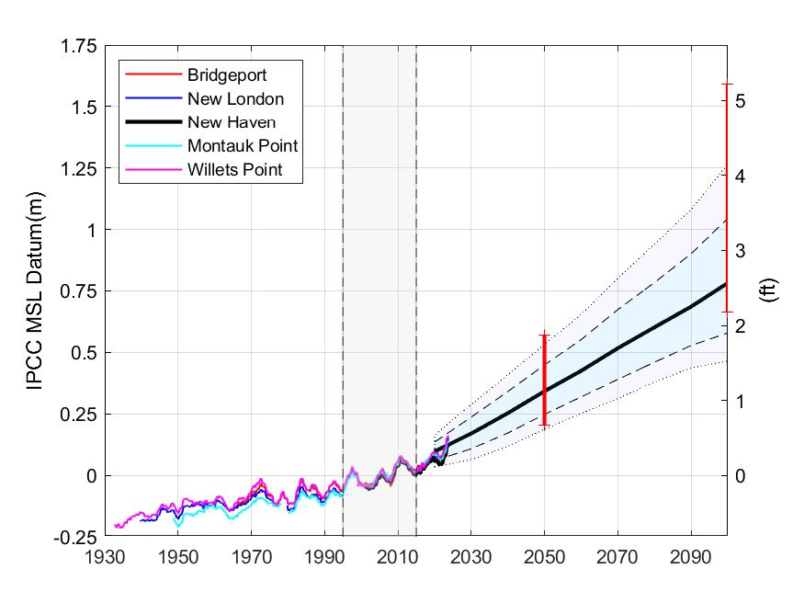
Update of the Connecticut Climate Report
Extreme Heat
Precipitation
Sea Level Rise

Slide 17
Update of the Connecticut Climate Report
Extreme Heat
Precipitation
Sea Level Rise
The upper bound of likely sea-level-rise in Long Island Sound by 2050 remains 20”
This will remain the PLANNING THRESHOLD for municipalities in Connecticut
Don’t call it a “projection”

Slide 18
State Resources and Tools
Climate Change Vulnerability Index (CCVI) for Flood Vulnerabilities and Heat Vulnerabilities
Climate Change Vulnerability Index (CCVI)
CT Environmental Justice Mapper (EJ Screen)
Resilience Opportunity Area Mapping (ROARs)
This is a planning tool developed by CIRCA for use Statewide; it shows vulnerability which is not the same as risk.
  Vulnerability = sensitivity X exposure / adaptive capacity.
  The CCVI is a ranked score tool. Numbers are relative (no units!) and can be used only within Connecticut.
The tool can be used for all kinds of planning and grant applications like the DEEP Climate Resilience Fund

Slide 19
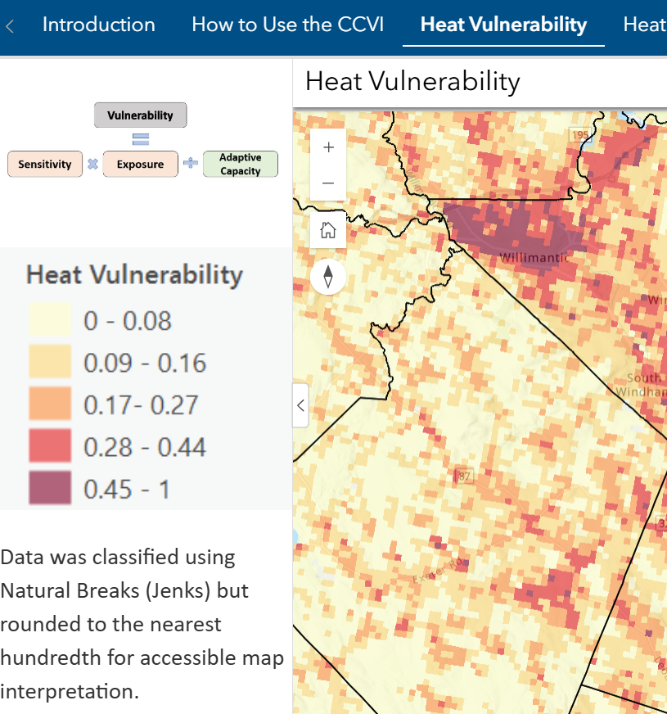
State Resources and Tools
Climate Change Vulnerability Index (CCVI)
Environmental Justice Mapper (EJ Screen)
Resilience Opportunity Area Mapping (ROARs)
Pavement
People working outside

Slide 20
State Resources and Tools
Versions 1.0 and 2.0 were developed by CIRCA; DEEP is handling Version 3.0
Climate Change Vulnerability Index (CCVI)
Environmental Justice Mapper (EJ Screen)
Resilience Opportunity Area Mapping (ROARs)
Connecticut EJ Screening Tool is an interactive resource that incorporates environmental burdens and demographic indicators.
The map allows users to explore the environmental health and the conditions (socioeconomic and or other community characteristics) within a specific region, town, city, and or entire state.
Data aggregated into a score that allows users to understand environmental justice conditions.

Slide 21
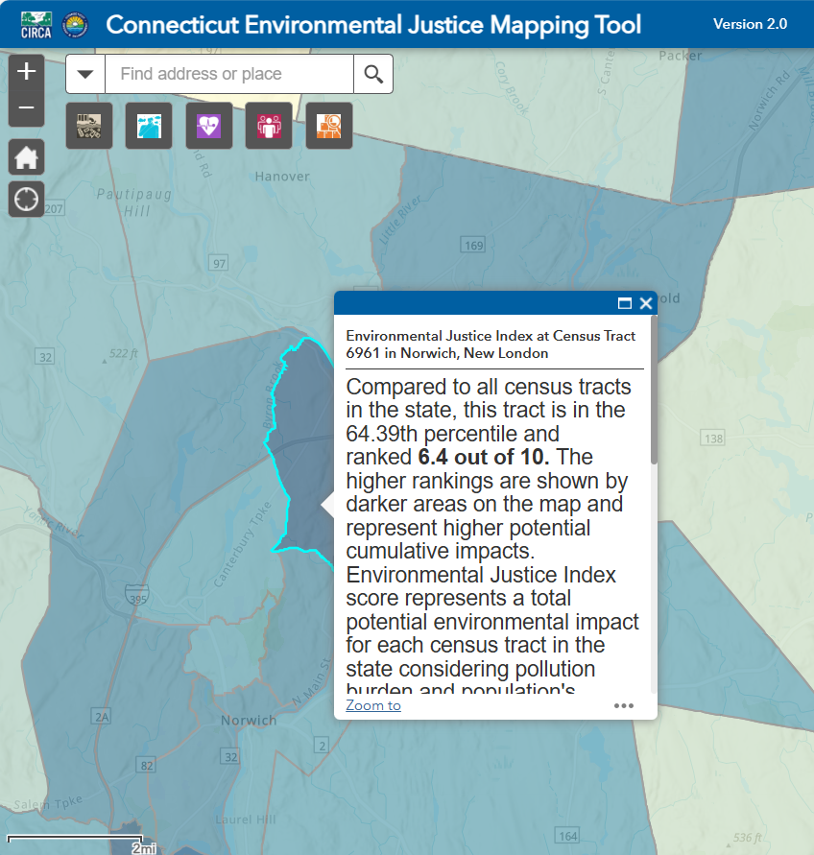
State Resources and Tools
Climate Change Vulnerability Index (CCVI)
Environmental Justice Mapper (EJ Screen)
Resilience Opportunity Area Mapping (ROARs)

Slide 22
State Resources and Tools
Climate Adaptation and
Resilience Opportunities
Climate Change Vulnerability Index (CCVI)
Environmental Justice Mapper (EJ Screen)
Resilience Opportunity Area Mapping (ROARs)
Delineated during deployment of the Resilient Connecticut program to identify areas where studies and concept designs could be advanced to address climate challenges.
Most areas are based on a typology (for example, clusters of critical facilities, historic and cultural resources, TOD, etc.)

Slide 23
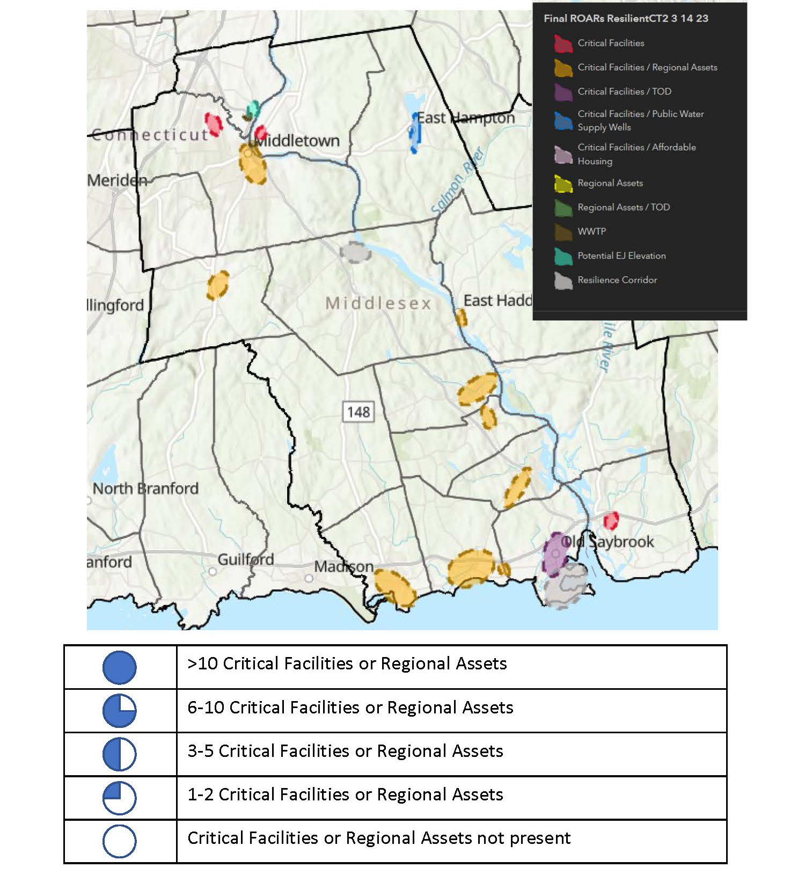
State Resources and Tools
Climate Change Vulnerability Index (CCVI)
Environmental Justice Mapper (EJ Screen)
Resilience Opportunity Area Mapping (ROARs)

Slide 24
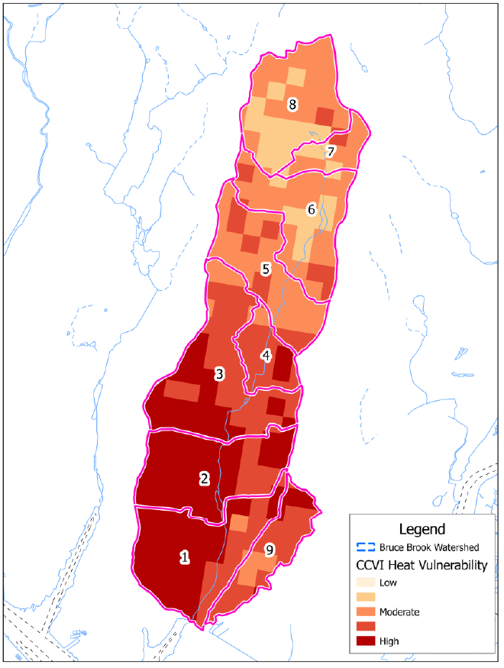
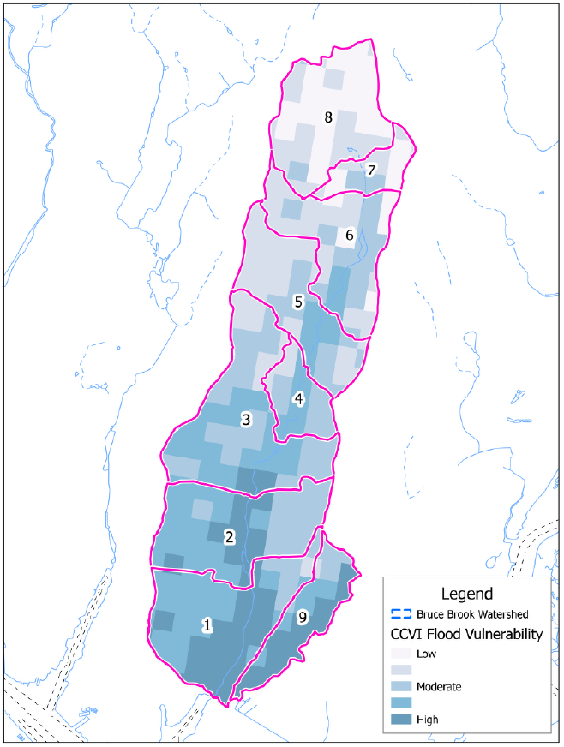
Examples of How to Use Resources and Tools
Watershed Based Plans
Hazard Mitigation Plans
Selecting Cooling Centers
Concept Designs
Heat and flood vulnerability mapping tools were used to ensure that actions and projects would reduce vulnerabilities where most needed
Bruce Brook Watershed
Based Plan

Slide 25
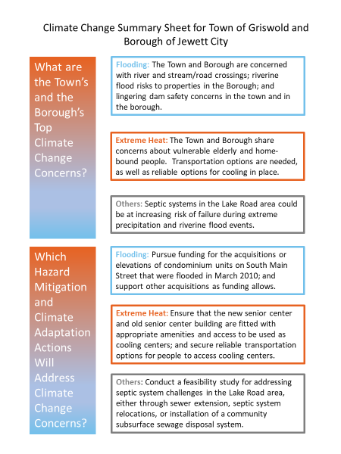
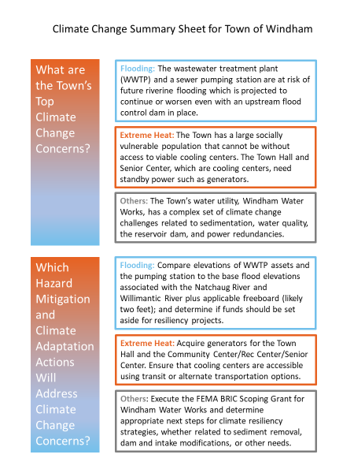
Examples of How to Use Resources and Tools
Watershed Based Plans
Hazard Mitigation Plans
Selecting Cooling Centers
Concept Designs
Southeastern Connecticut Hazard Mitigation and
Climate Adaptation Plan

Slide 26
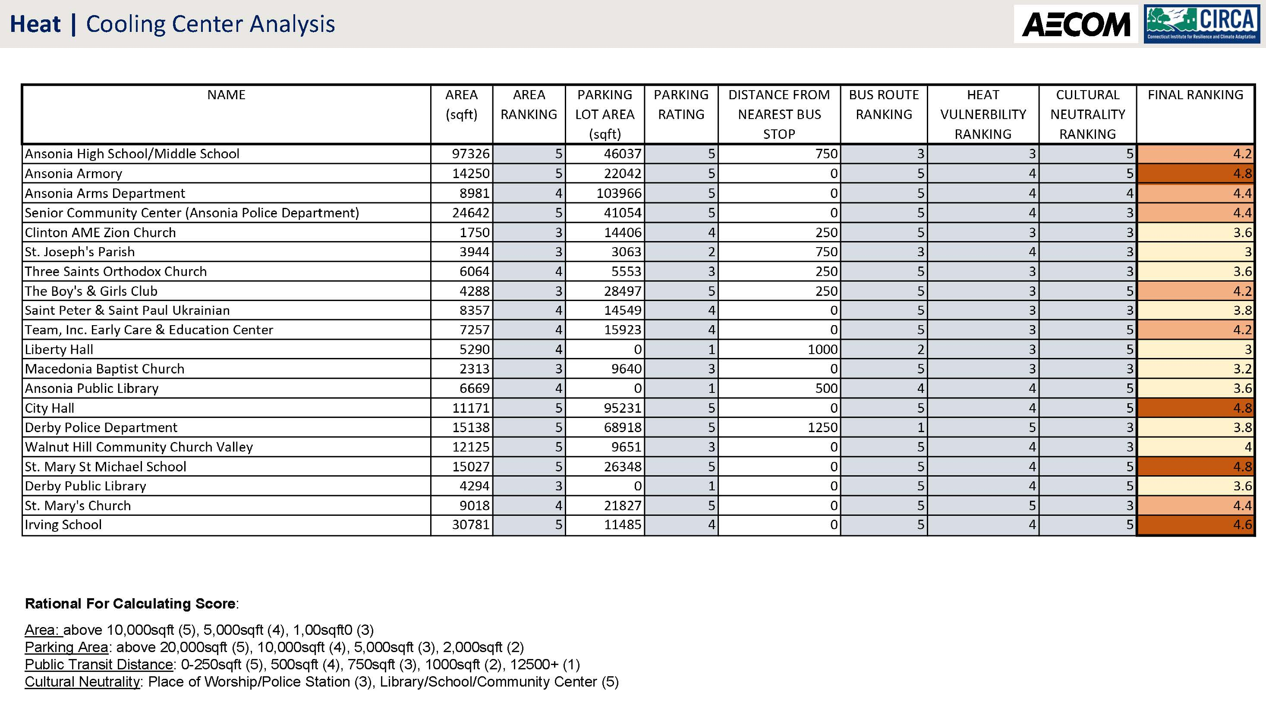
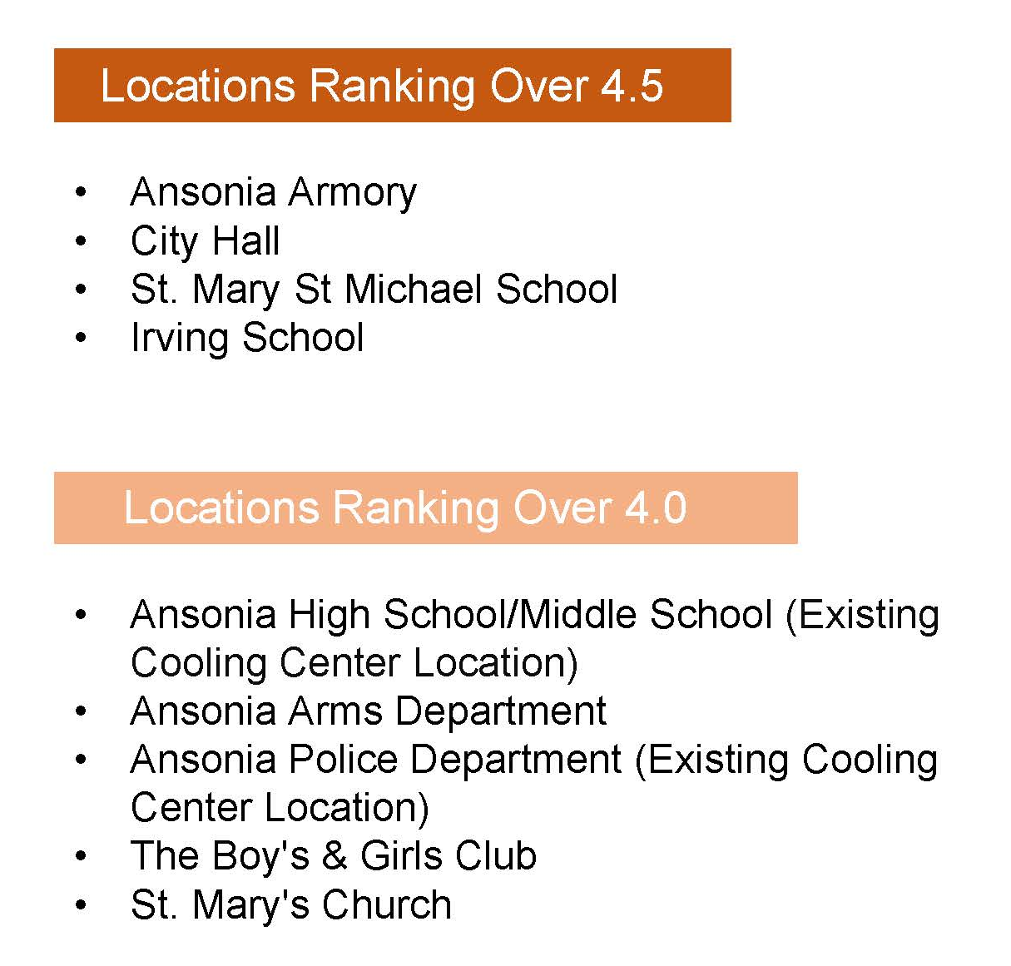
Examples of How to Use Resources and Tools
Watershed Based Plans
Hazard Mitigation Plans
Selecting Cooling Centers
Concept Designs
“Resilient Ansonia”

Slide 27
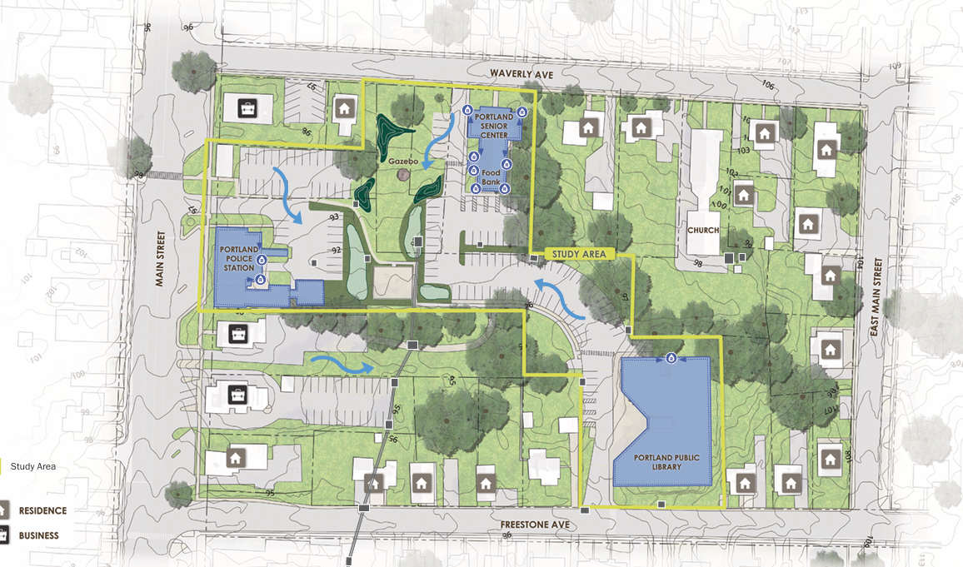
Examples of How to Use Resources and Tools
Watershed Based Plans
Hazard Mitigation Plans
Selecting Cooling Centers
Concept Designs
“Resilient Portland”

Slide 28
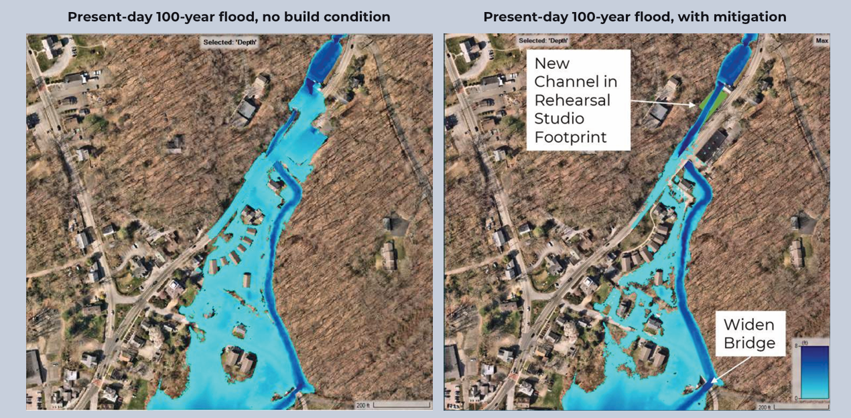
Examples of How to Use Resources and Tools
Watershed Based Plans
Hazard Mitigation Plans
Selecting Cooling Centers
Concept Designs
“Resilient East Haddam”

Slide 29
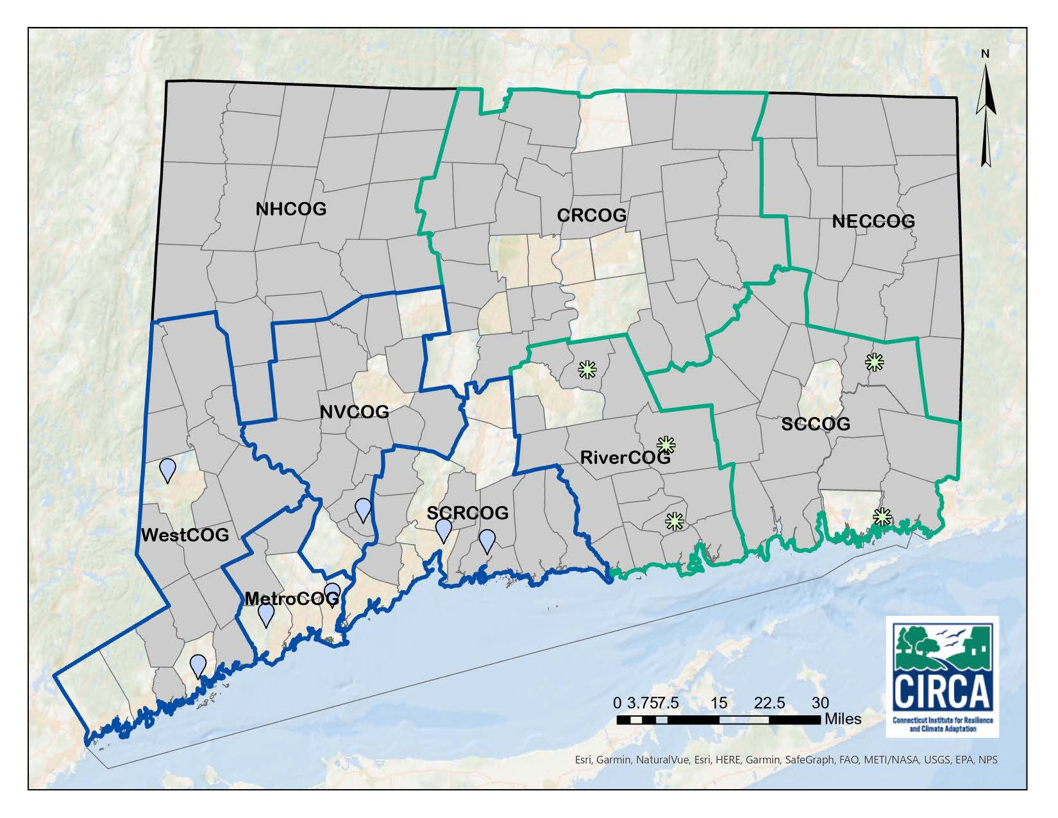
What’s Next in Connecticut?
Resilient Connecticut 1.0 (blue boundary) was piloted in southwestern CT in 2020-2021
Resilient Connecticut 2.0 (green boundary) was deployed in RiverCOG, SCCOG, and CRCOG in 2022-2023

Slide 30
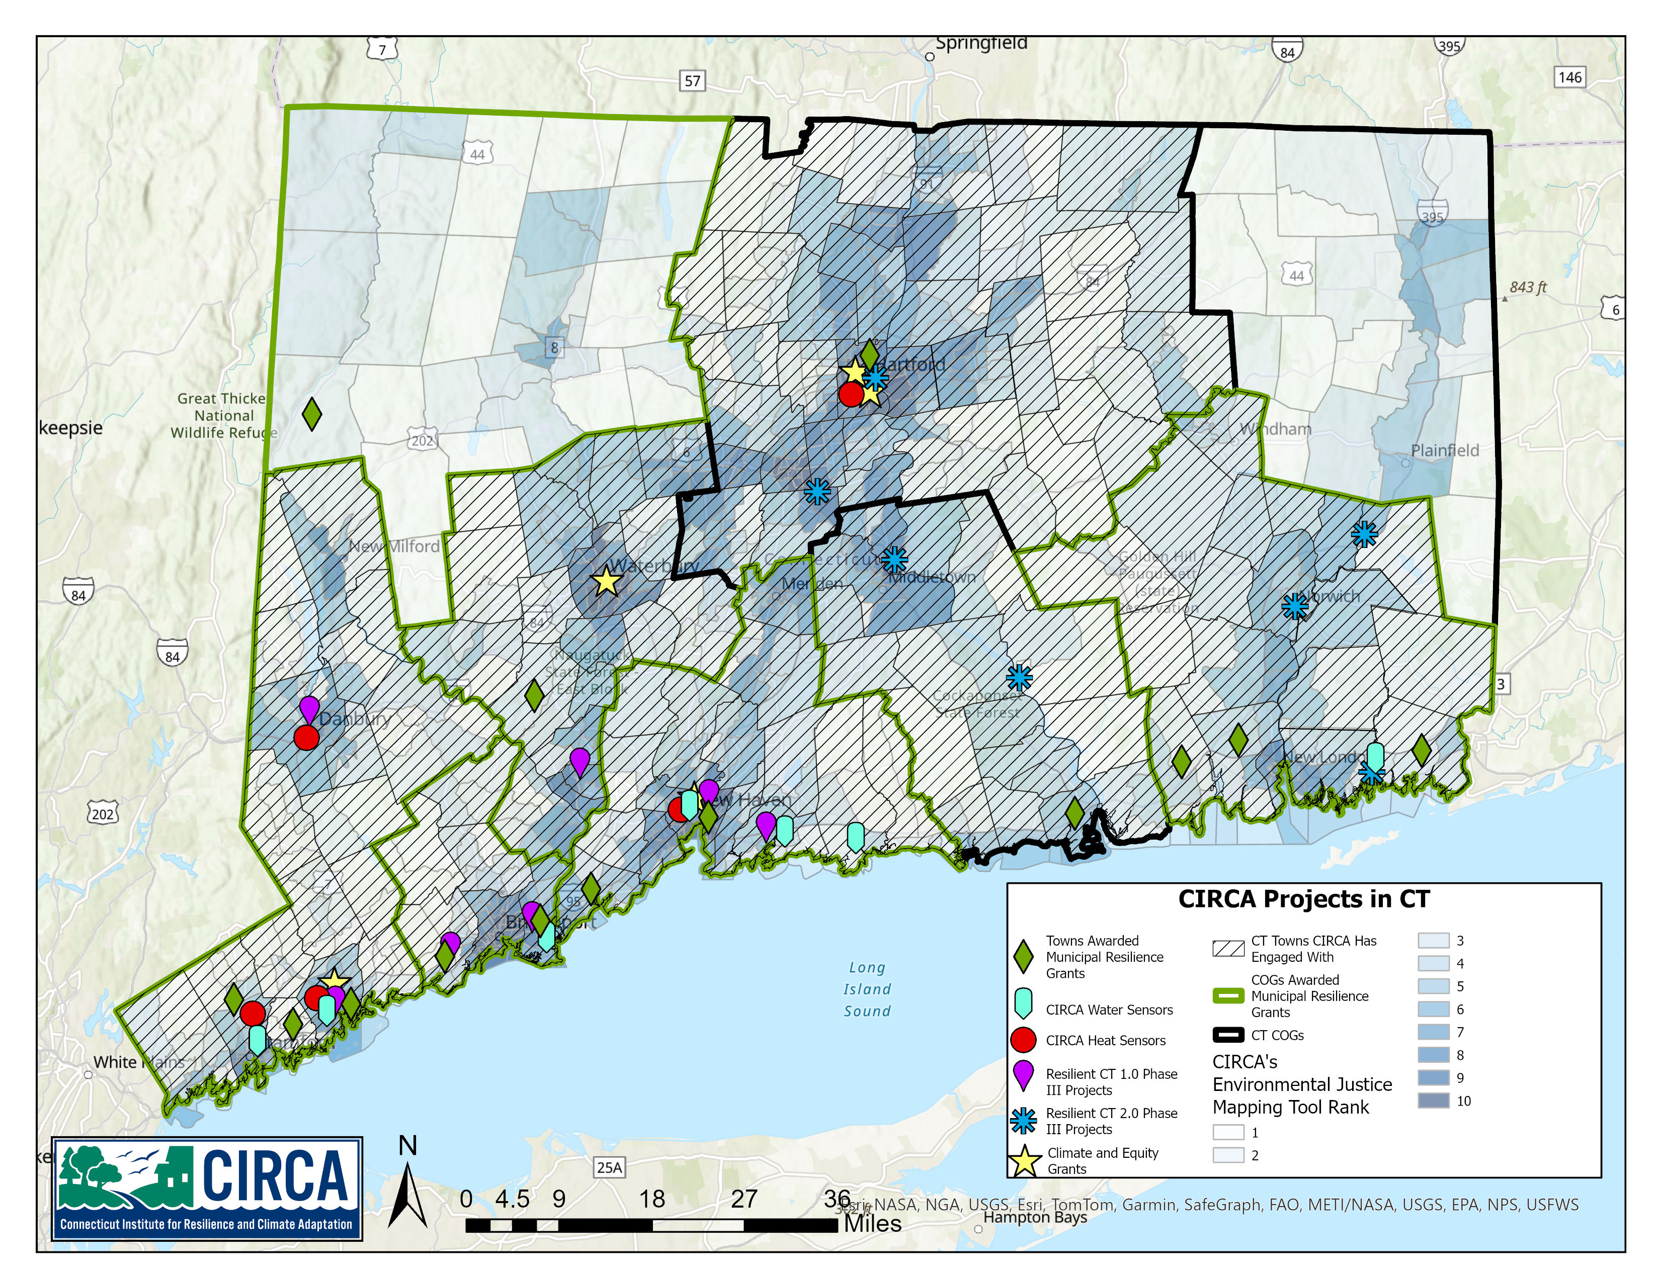
What’s Next in Connecticut?
Studies and concept designs have been advanced in many municipalities
Small towns such as Jewett City, Stonington, East Haddam, and Portland are now positioned for State and FEMA $$

Slide 31
What’s Next in Connecticut?
Resilient Connecticut 3.0 is coming to NHCOG and NECCOG!
Watch for invitations from CIRCA to meet in 2026

Slide 32
Agenda Item #2. Public Act 25-33
New Concepts
Hazard Mitigation Plans
Plans of Conservation and Development
Early Implementation Examples (POCDs)
What’s Next for Small Towns?

Slide 33
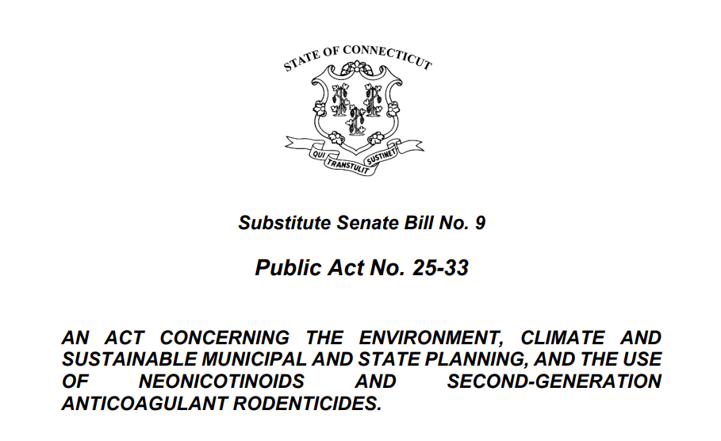
New Concepts
Resiliency Improvement Districts
District Master Plan
Transfer of Development Rights
Sending Areas
Receiving Areas
"Resiliency improvement district" means an area wholly within the corporate limits of one or more municipalities that has been established and designated as such pursuant to section 22 of this act and that is to be developed in accordance with a district master plan.

Slide 34
New Concepts
Resiliency Improvement Districts
District Master Plan
Transfer of Development Rights
Sending Areas
Receiving Areas
"Resiliency improvement district" means an area wholly within the corporate limits of one or more municipalities that has been established and designated as such pursuant to section 22 of this act and that is to be developed in accordance with a district master plan.

Slide 35
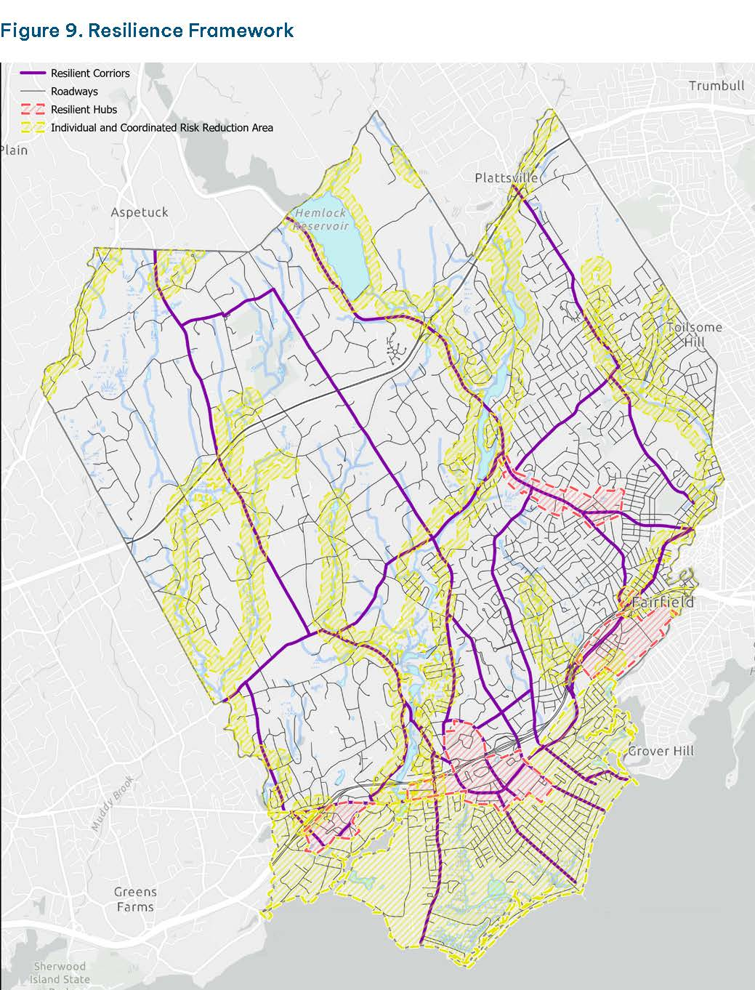
New Concepts
Resiliency Improvement Districts
District Master Plan
Transfer of Development Rights
Sending Areas
Receiving Areas
The Fairfield POCD defines resilient hubs and resilient corridors; these are potential components of resiliency improvement districts

Slide 36
New Concepts
Resiliency Improvement Districts
District Master Plan
Transfer of Development Rights
Sending Areas
Receiving Areas
"District master plan" means a statement of means and objectives prepared by the municipality… relating to a resiliency improvement district that is designed to (A) reduce the risk of, or exposure to, extreme events, hazards and the effects of climate change, (B) support economic development, (C) provide housing opportunities in existing residential areas, (D) improve or broaden the tax base, and (E) construct or improve the physical facilities and structures necessary for resilience projects, environmental infrastructure or clean energy projects, or any combination thereof...

Slide 37
New Concepts
Resiliency Improvement Districts
District Master Plan
Transfer of Development Rights
Sending Areas
Receiving Areas
Not defined in the Act
CIRCA’s fact sheet defines transfer of development rights as “a regulatory technique allowing development rights to a property to be severed, transferred, and relocated to another parcel of land.”

Slide 38
New Concepts
Resiliency Improvement Districts
District Master Plan
Transfer of Development Rights
Sending Areas
Receiving Areas
"Sending site" means one or more designated sites or areas of land in which development rights are designated for use in one or more receiving sites.
"Receiving site" means one or more designated sites or areas of land to which development rights generated from one or more sending sites may be transferred and in which increased development is permitted to occur by reason of such transfer.

Slide 39
New Concepts
Resiliency Improvement Districts
District Master Plan
Transfer of Development Rights
Sending Areas
Receiving Areas
Eligible sending sites may include, but need not be limited to, (1) core forest, as defined in section 16a-3k, (2) land classified as farm land in accordance with section 12-107c, (3) agricultural land, as defined in section 22-3, (4) areas identified as containing habitat for endangered or threatened species pursuant to (A) federal law, (B) section 26-306 or 26-308, or (C) a written determination of the United States Fish and Wildlife Service or a state and federally recognized tribe that such area is appropriate for the preservation of endangered or threatened species habitat, and (5) areas within the boundaries of any area impacted by the most recent sea level change scenario updated pursuant to subsection (b) of section 25-68o, or a floodplain, as defined in section 25-68i.

Slide 40
New Concepts
Resiliency Improvement Districts
District Master Plan
Transfer of Development Rights
Sending Areas
Receiving Areas
Each receiving site shall (1) be eligible for connection with a public water system, (2) be located not more than one-half mile from public transportation facilities, as defined in section 13b-79kk, (3) not be located within the boundaries of core forest, as defined in section 16a-3k, (4) not be located within the boundaries of any area impacted by the most recent sea level change scenario updated pursuant to subsection (b) of section 25-68o, and (5) be located above the one-hundred-year flood elevation.

Slide 41
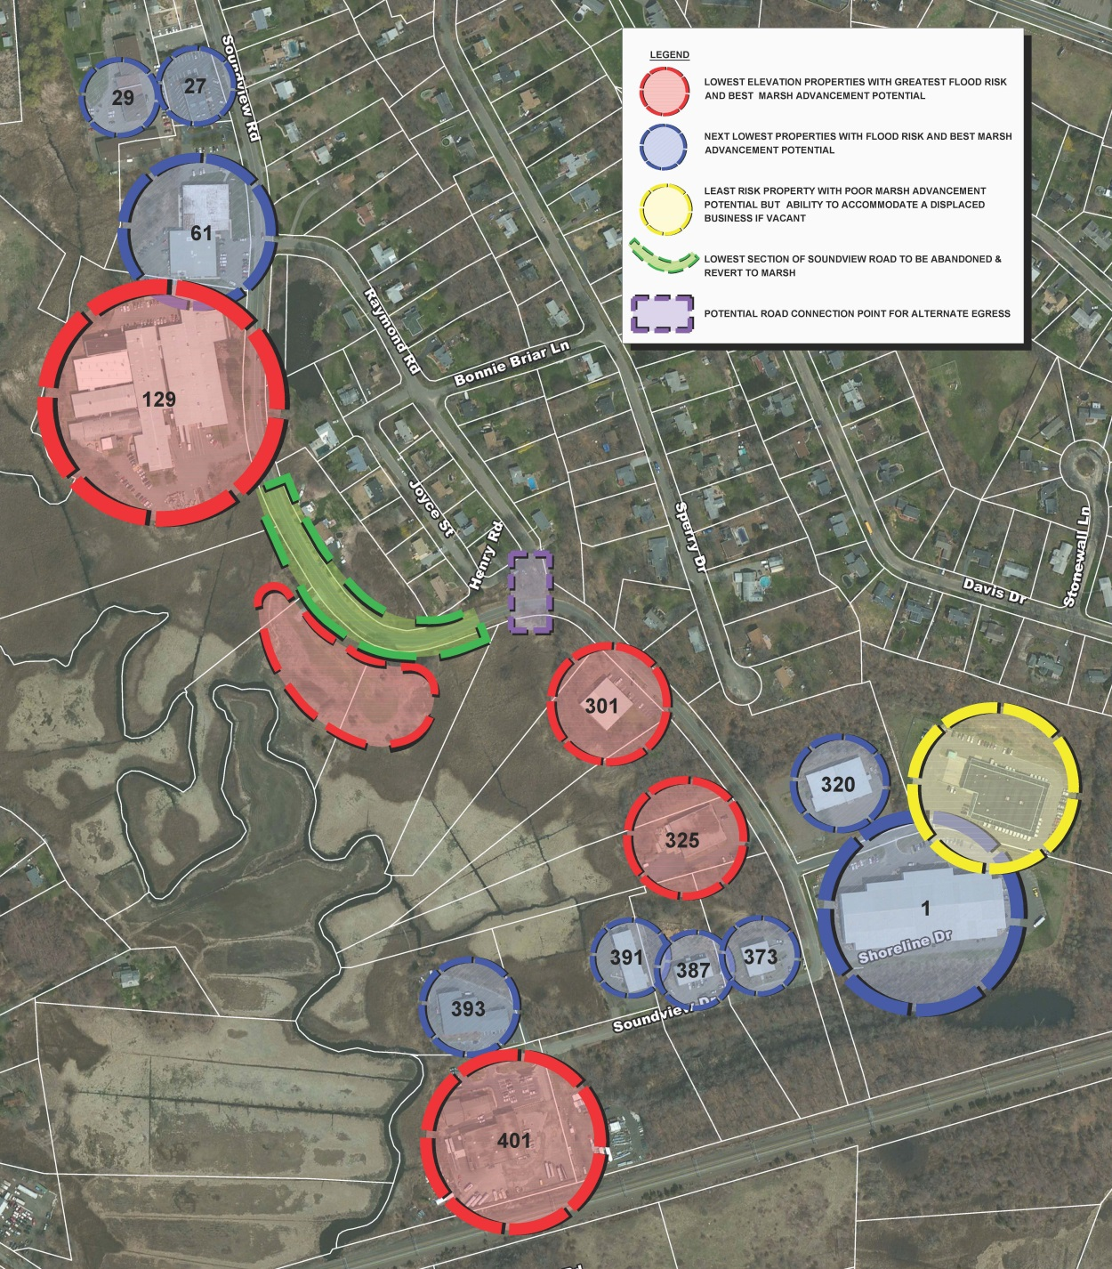
New Concepts
Resiliency Improvement Districts
District Master Plan
Transfer of Development Rights
Sending Areas
Receiving Areas
The Guilford Coastal Resilience Plan (2014) depicted sending and receiving areas in the Soundview Road business park

Slide 42
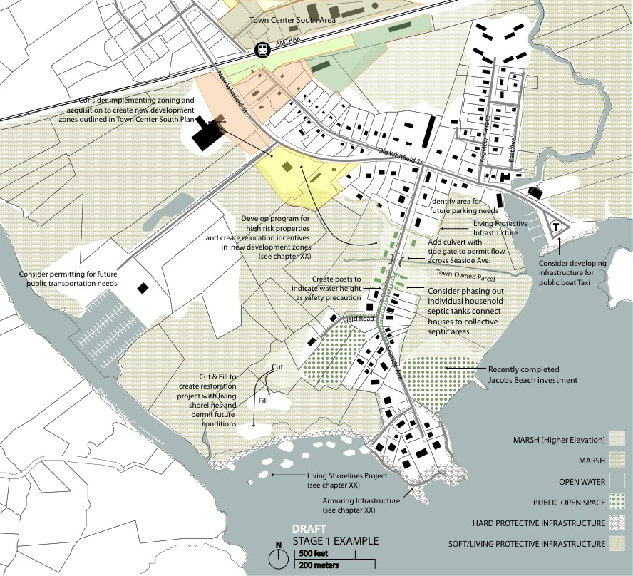
New Concepts
Resiliency Improvement Districts
District Master Plan
Transfer of Development Rights
Sending Areas
Receiving Areas
The Guilford Coastal Resilience Plan (2014) depicted sending and receiving areas in the Lower Whitfield/Jacobs Beach area.

Slide 43
Hazard Mitigation Plans
Changes to the Planning Process
Data Delivery
Ideas for Plan Actions
On and after October 1, 2019, in the preparation of any municipal evacuation plan or hazard mitigation plan, such municipality shall consider the most recent sea level change scenario updated pursuant to subsection (b) of this section.
On and after October 1, 2027, any such municipal evacuation or hazard mitigation plan shall identify and address (A) threats to surface transportation, critical infrastructure and local land uses as a result of such sea level change, and (B) actions, strategies and capital projects to avoid or reduce the impacts and risks resulting from climate change, including, but not limited to, increased precipitation, flooding, sea level rise and extreme heat.
This is mostly done. FEMA already requires that hazards be reviewed relative to critical transportation, critical facilities, and land uses.

Slide 44
Hazard Mitigation Plans
Changes to the Planning Process
Data Delivery
Ideas for Plan Actions
Any such surface transportation, critical infrastructure, local land uses, actions, strategies and capital projects shall be identified in geospatial data, as applicable, in addition to being identified in such plan, and such data shall be made available to the Commissioner of Emergency Services and Public Protection, the Commissioner of Transportation and the Secretary of the Office of Policy and Management upon request. Such geospatial data shall be produced in the plane coordinate system, as described in section 13a-255. Such work may be conducted on a regional basis.
This section places a new requirement on plan developers (municipalities, COGs, and their consultants) that is above and beyond the requirements of from FEMA.

Slide 45
Hazard Mitigation Plans
Changes to the Planning Process
Data Delivery
Ideas for Plan Actions
On or before May 1, 2028, and annually thereafter, each municipality shall submit a geospatial data file of each culvert and bridge within the control and boundaries of such municipality to the regional council of governments of which it is a member in a form and manner prescribed by the Office of Policy and Management, in consultation with the Departments of Transportation and Energy and Environmental Protection.
This places additional work in the hands of the municipal staff. Ask your COGs to do it for themselves.

Slide 46
Hazard Mitigation Plans
Changes to the Planning Process
Data Delivery
Ideas for Plan Actions
For [RPOCDs] adopted on or after October 1, 2025, such plan shall (i) demonstrate consistency with the regional long-range transportation plan and the regional summary of the hazard mitigation plan in the case of a multijurisdictional hazard mitigation plan, and (ii) identify critical facilities in the region and include geospatial data relative to such facilities. Such geospatial information shall indicate location, address and general function of the critical facility.
RPOCDs should already be developing geospatial data that may exceed the quality and granularity of the hazard mitigation plan that is in place.

Slide 47
Hazard Mitigation Plans
Changes to the Planning Process
Data Delivery
Ideas for Plan Actions
Ensure that actions are present for critical facilities and transportation systems (this is mostly done already).
Create an action that calls for development and maintenance of a geospatial data file of each culvert and bridge within the control and boundaries of such municipality, including the information listed in the Act.

Slide 48
Plans of Conservation and Development
Changes to the Planning Process
Ideas for Plan Strategies and Maps
For any POCD adopted on or after October 1, 2027, consider the most recent hazard and climate projections established by federal and state authorities, including, but not limited to, the National Oceanic and Atmospheric Administration, the Federal Emergency Management Agency, the United States Environmental Protection Agency and The University of Connecticut.
This will place more responsibility in the hands of CIRCA.

Slide 49
Plans of Conservation and Development
Changes to the Planning Process
Ideas for Plan Strategies and Maps
… Must include a climate change vulnerability assessment, based on information from considerations which shall consist of an assessment of existing and anticipated threats to and vulnerabilities of the municipality that are associated with natural disasters, hazards and climate change, including, but not limited to, increased temperatures, drought, flooding, wildfire, storm damage and sea level rise, saltwater intrusion and the impacts such disasters and hazards may have on individuals, communities, institutions, businesses, economic development, public infrastructure and facilities, public health, safety and welfare…
This will be available in the hazard mitigation plan and is not necessary to develop *for* the POCD.

Slide 50
Plans of Conservation and Development
Changes to the Planning Process
Ideas for Plan Strategies and Maps
… Must identify goals, policies and techniques to avoid or reduce such threats, vulnerabilities and impacts, and include a statement describing any consistencies and inconsistencies identified between such assessment and any existing or proposed municipal natural hazard mitigation plan, floodplain management plan, comprehensive emergency operations plan, emergency response plan, post-disaster recovery plan, long range transportation plan or capital improvement plan in the municipality, and identify and recommend, where necessary, the integration of data from such assessment into any such plans and any actions necessary to achieve consistency and coordination between such assessment and any such plans…
This will not be available in the hazard mitigation plan. New goals and policies will be necessary for the POCD.

Slide 51
Plans of Conservation and Development
Changes to the Planning Process
Ideas for Plan Strategies and Maps
…Must include a map showing such proposed land uses which considers the threats, vulnerabilities and impacts identified in the climate change vulnerability assessment conducted pursuant to subparagraph of this subdivision…
Note that this is not asking for a map of hazards; it is requiring the proposed land use map to consider these risks.

Slide 52
Plans of Conservation and Development
Changes to the Planning Process
Ideas for Plan Strategies and Maps
…identify infrastructure, including, but not limited to, facilities, public utilities and roadways, that is critical for evacuation purposes and sustaining quality of life during a natural disaster, and that shall be maintained at all times in an operational state; identify strategies and design standards that may be implemented to avoid or reduce risks associated with natural disasters, hazards and climate change; and include geospatial data utilized in preparing such plan or that is necessary to convey information in such plan…
This should be available in the hazard mitigation plan and not necessary to develop *for* the POCD. However, not all of these items are in all hazard mitigation plans.

Slide 53
Plans of Conservation and Development
Changes to the Planning Process
Ideas for Plan Strategies and Maps
…Identify one or more areas that are vulnerable to the impacts of climate change for the purpose of prioritizing funding for infrastructure needs and resiliency planning. In preparing such plan the commission shall consider focusing development and revitalization in areas with existing or planned physical infrastructure. The commission or any special committee may utilize information and data from any natural hazard mitigation plan, floodplain management plan, comprehensive emergency operations plan, emergency response plan, post-disaster recovery plan, long-range transportation plan, climate vulnerability assessment or resilience plan in the preparation of such plan of conservation and development…
This section appears to make the requirements of the Act a little easier for some municipalities to implement. For example, some towns will not have the resources to develop new assessments of risk.

Slide 54
Plans of Conservation and Development
Changes to the Planning Process
Ideas for Plan Strategies and Maps
Such plan may show… (8) a land use program that will promote the reduction and avoidance of risks associated with natural disasters, hazards and climate change, including, but not limited to, increased temperatures, drought, flooding, wildfire, hurricanes, saltwater intrusion and sea level rise, (9) a program for the transfer of development rights, which establishes criteria for sending and receiving sites and technical details for the program consistent with the provisions of section 8-2e, as amended by this act, (10) identification of resiliency improvement districts, as defined in section 23 of this act…
This part ties the POCD back to the resiliency improvement district concept, sending sites, and receiving sites.

Slide 55
Plans of Conservation and Development
Changes to the Planning Process
Ideas for Plan Strategies and Maps
Possible Resiliency Strategies to Include in POCDs being developed in 2025-2026:
  “Evaluate the feasibility of creating a resiliency improvement district”
  “Explore the feasibility of a transfer of development rights (TDR) program”
This will help POCDs that are underway in 2025-2026 to avoid locking out potential funds available over the next decade.

Slide 56
Plans of Conservation and Development
Changes to the Planning Process
Ideas for Plan Strategies and Maps
Possible Maps to Include in POCDs being developed in 2025-2026:
  A “map showing such proposed land uses which considers the threats, vulnerabilities and impacts identified in the climate change vulnerability assessment” (from above)
  Potential resiliency improvement districts
  Potential sending and receiving areas
This will help POCDs that are underway in 2025-2026 to avoid locking out potential funds available over the next decade.

Slide 57
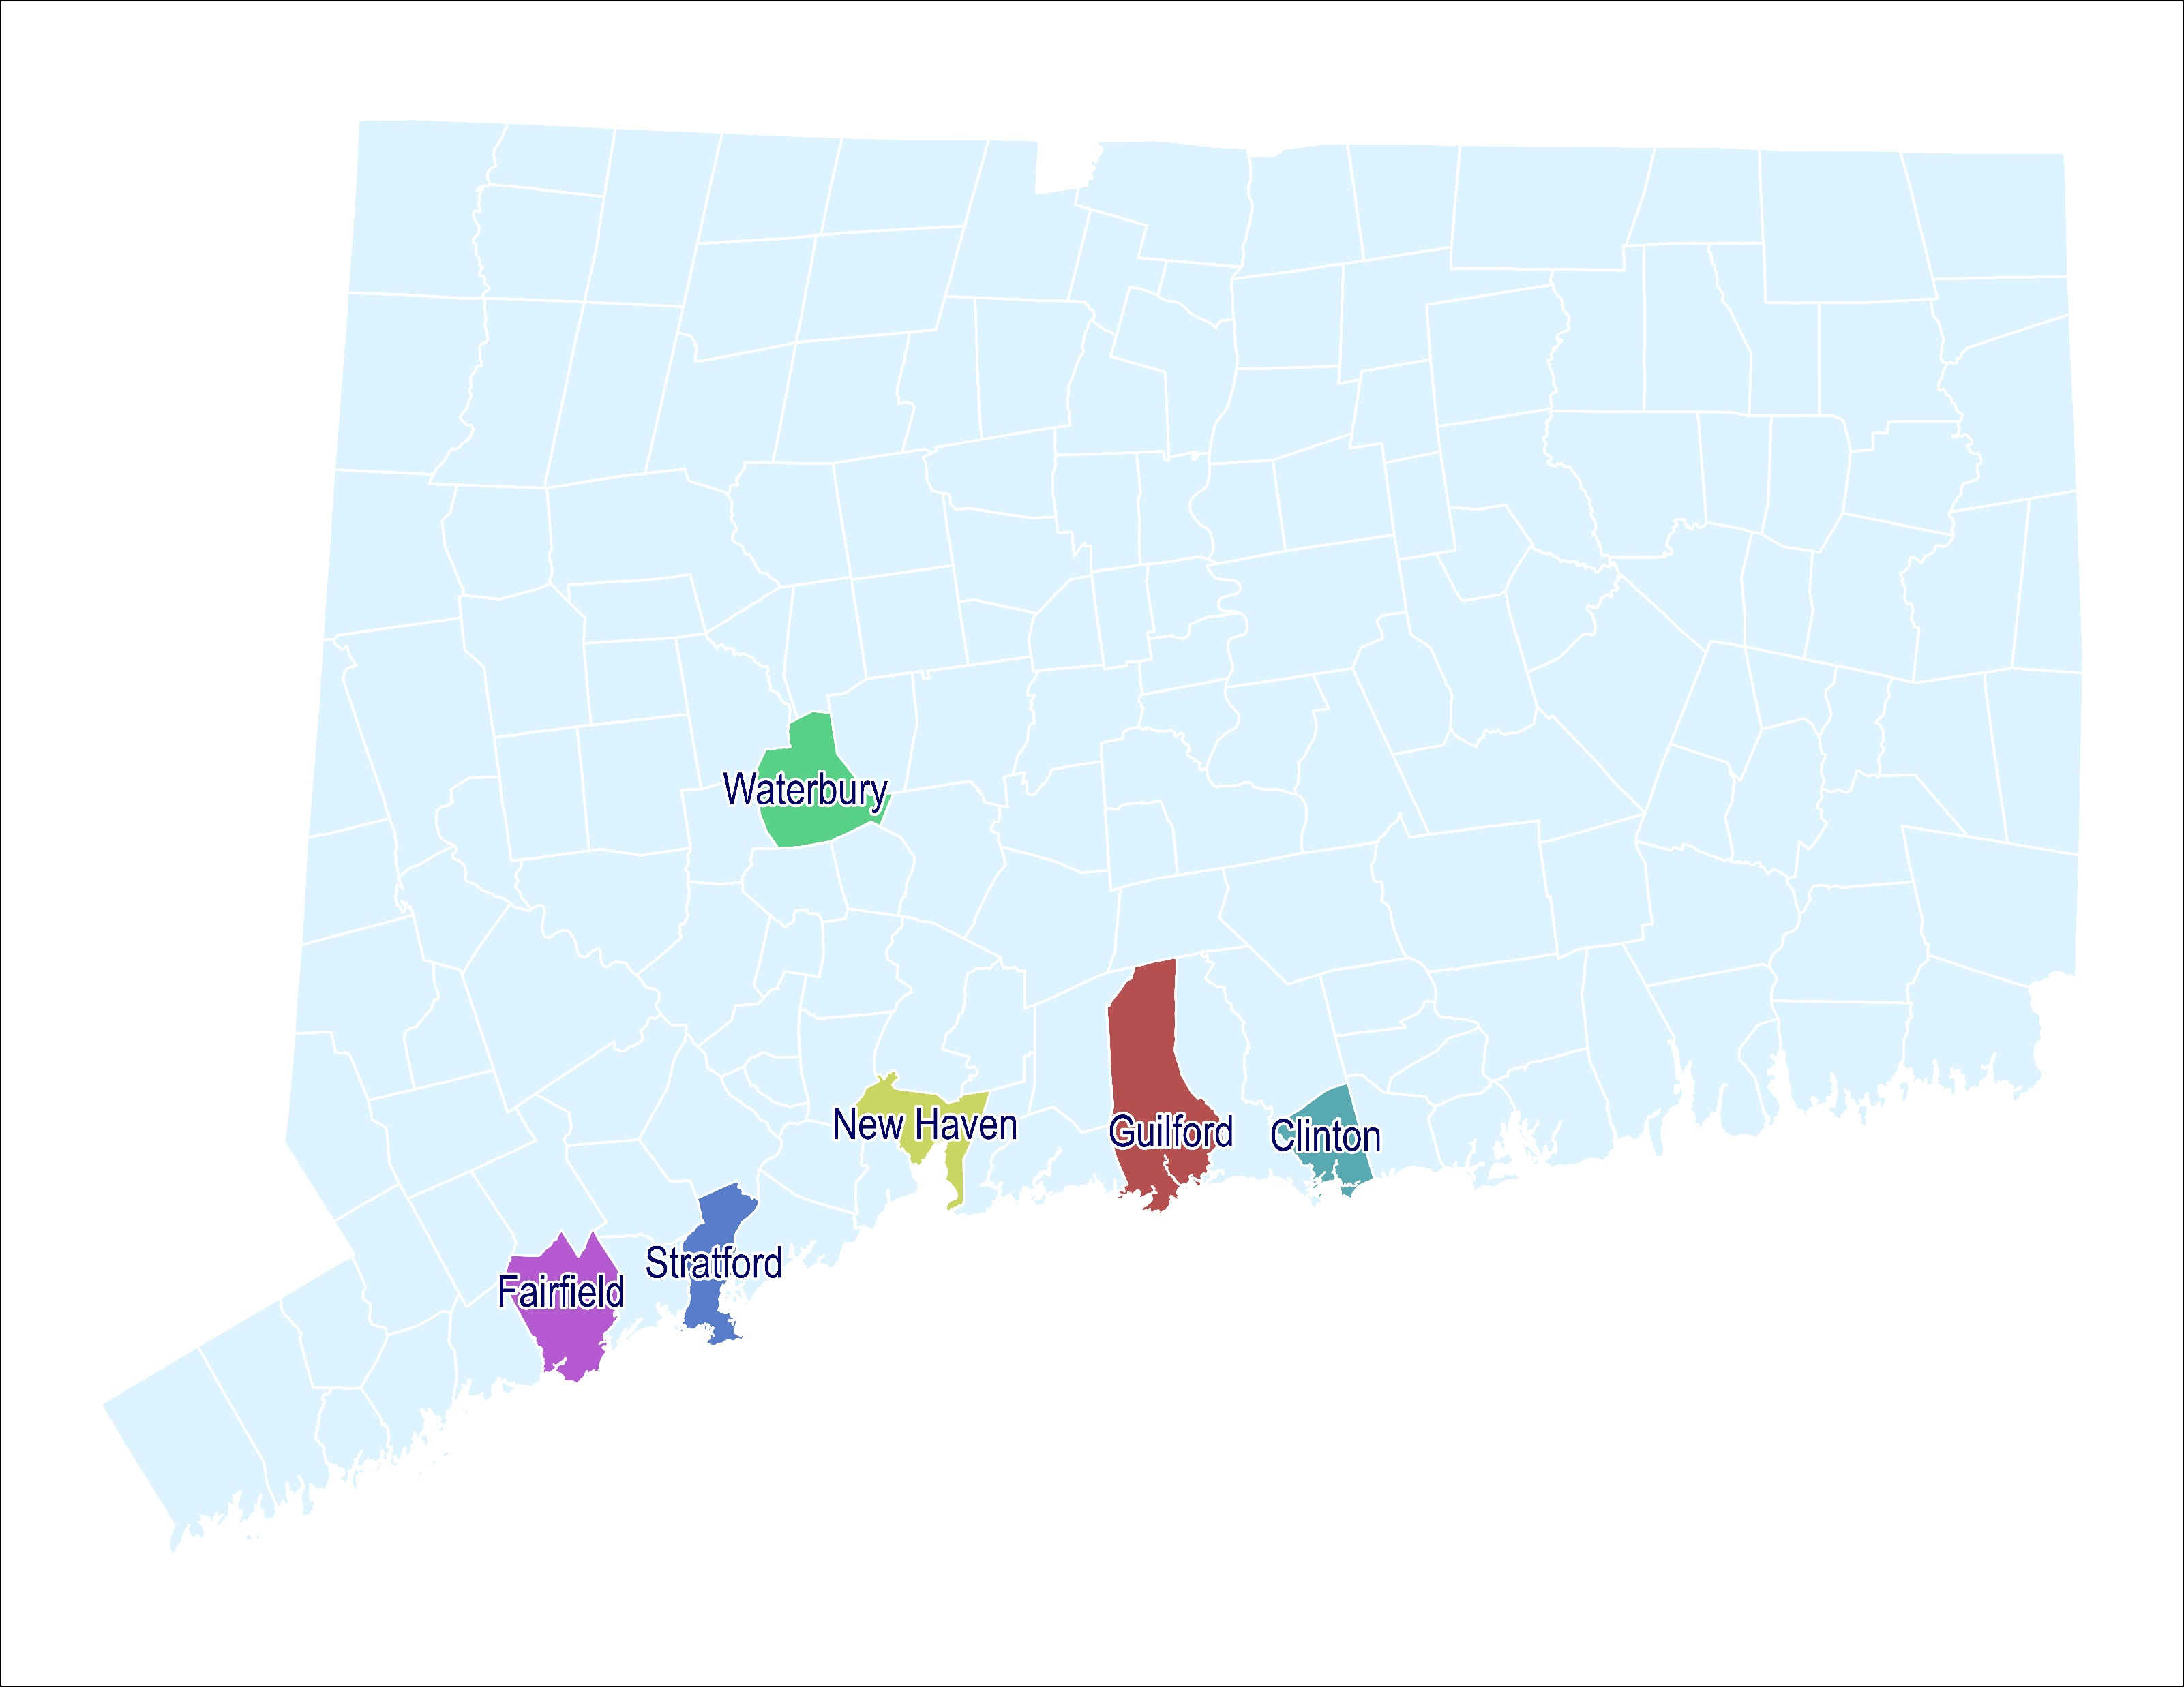
Early Implementation Examples (POCDs)
Please Note
These are POCDs that RLW has worked on from 2022-2025
We believe other municipalities are already incorporating climate challenge concepts into their POCDs
Not all pictured municipalities are COST members

Slide 58
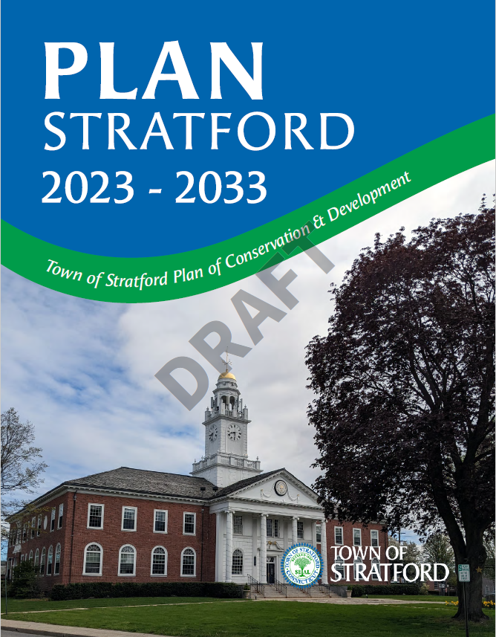
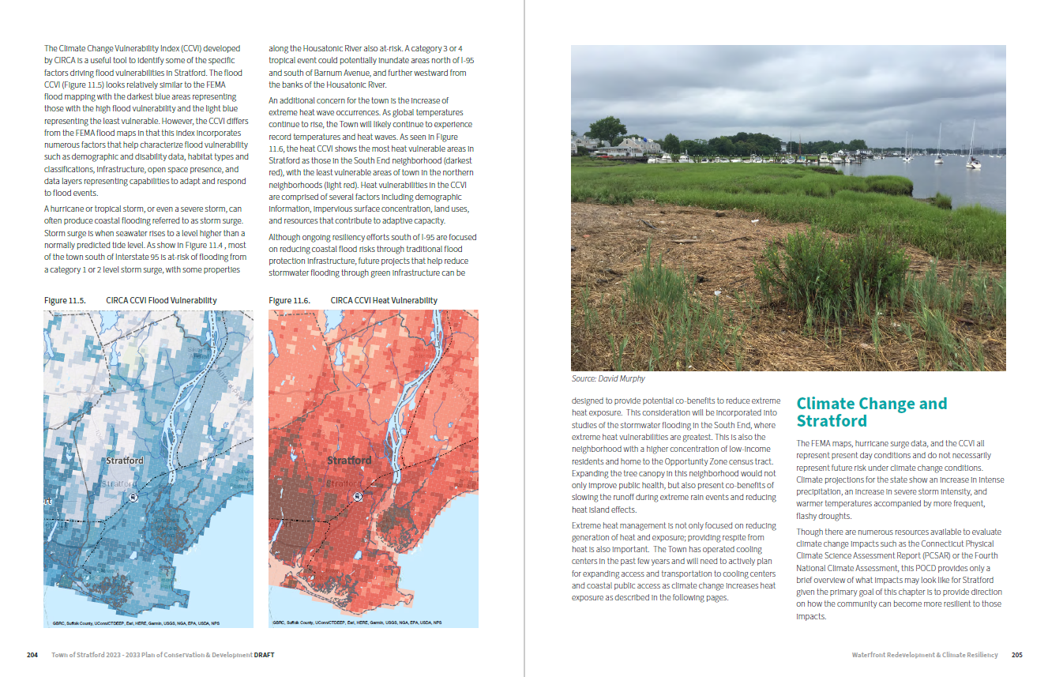
Early Implementation Examples
ADOPTED

Slide 59
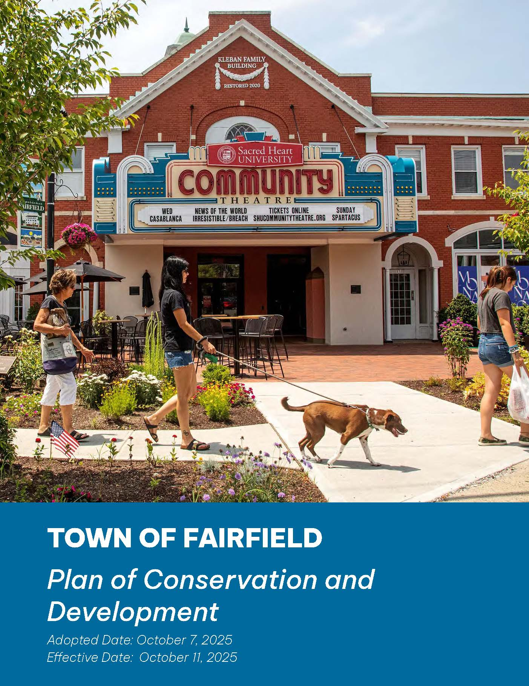
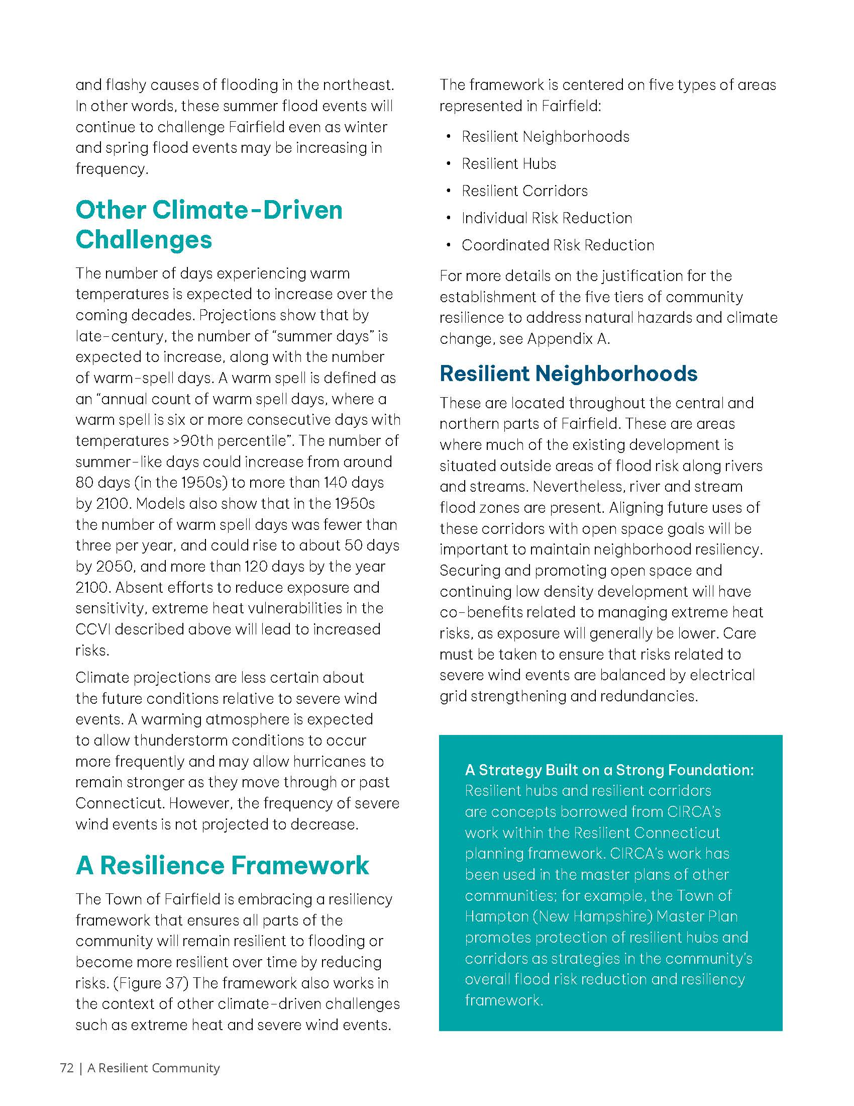
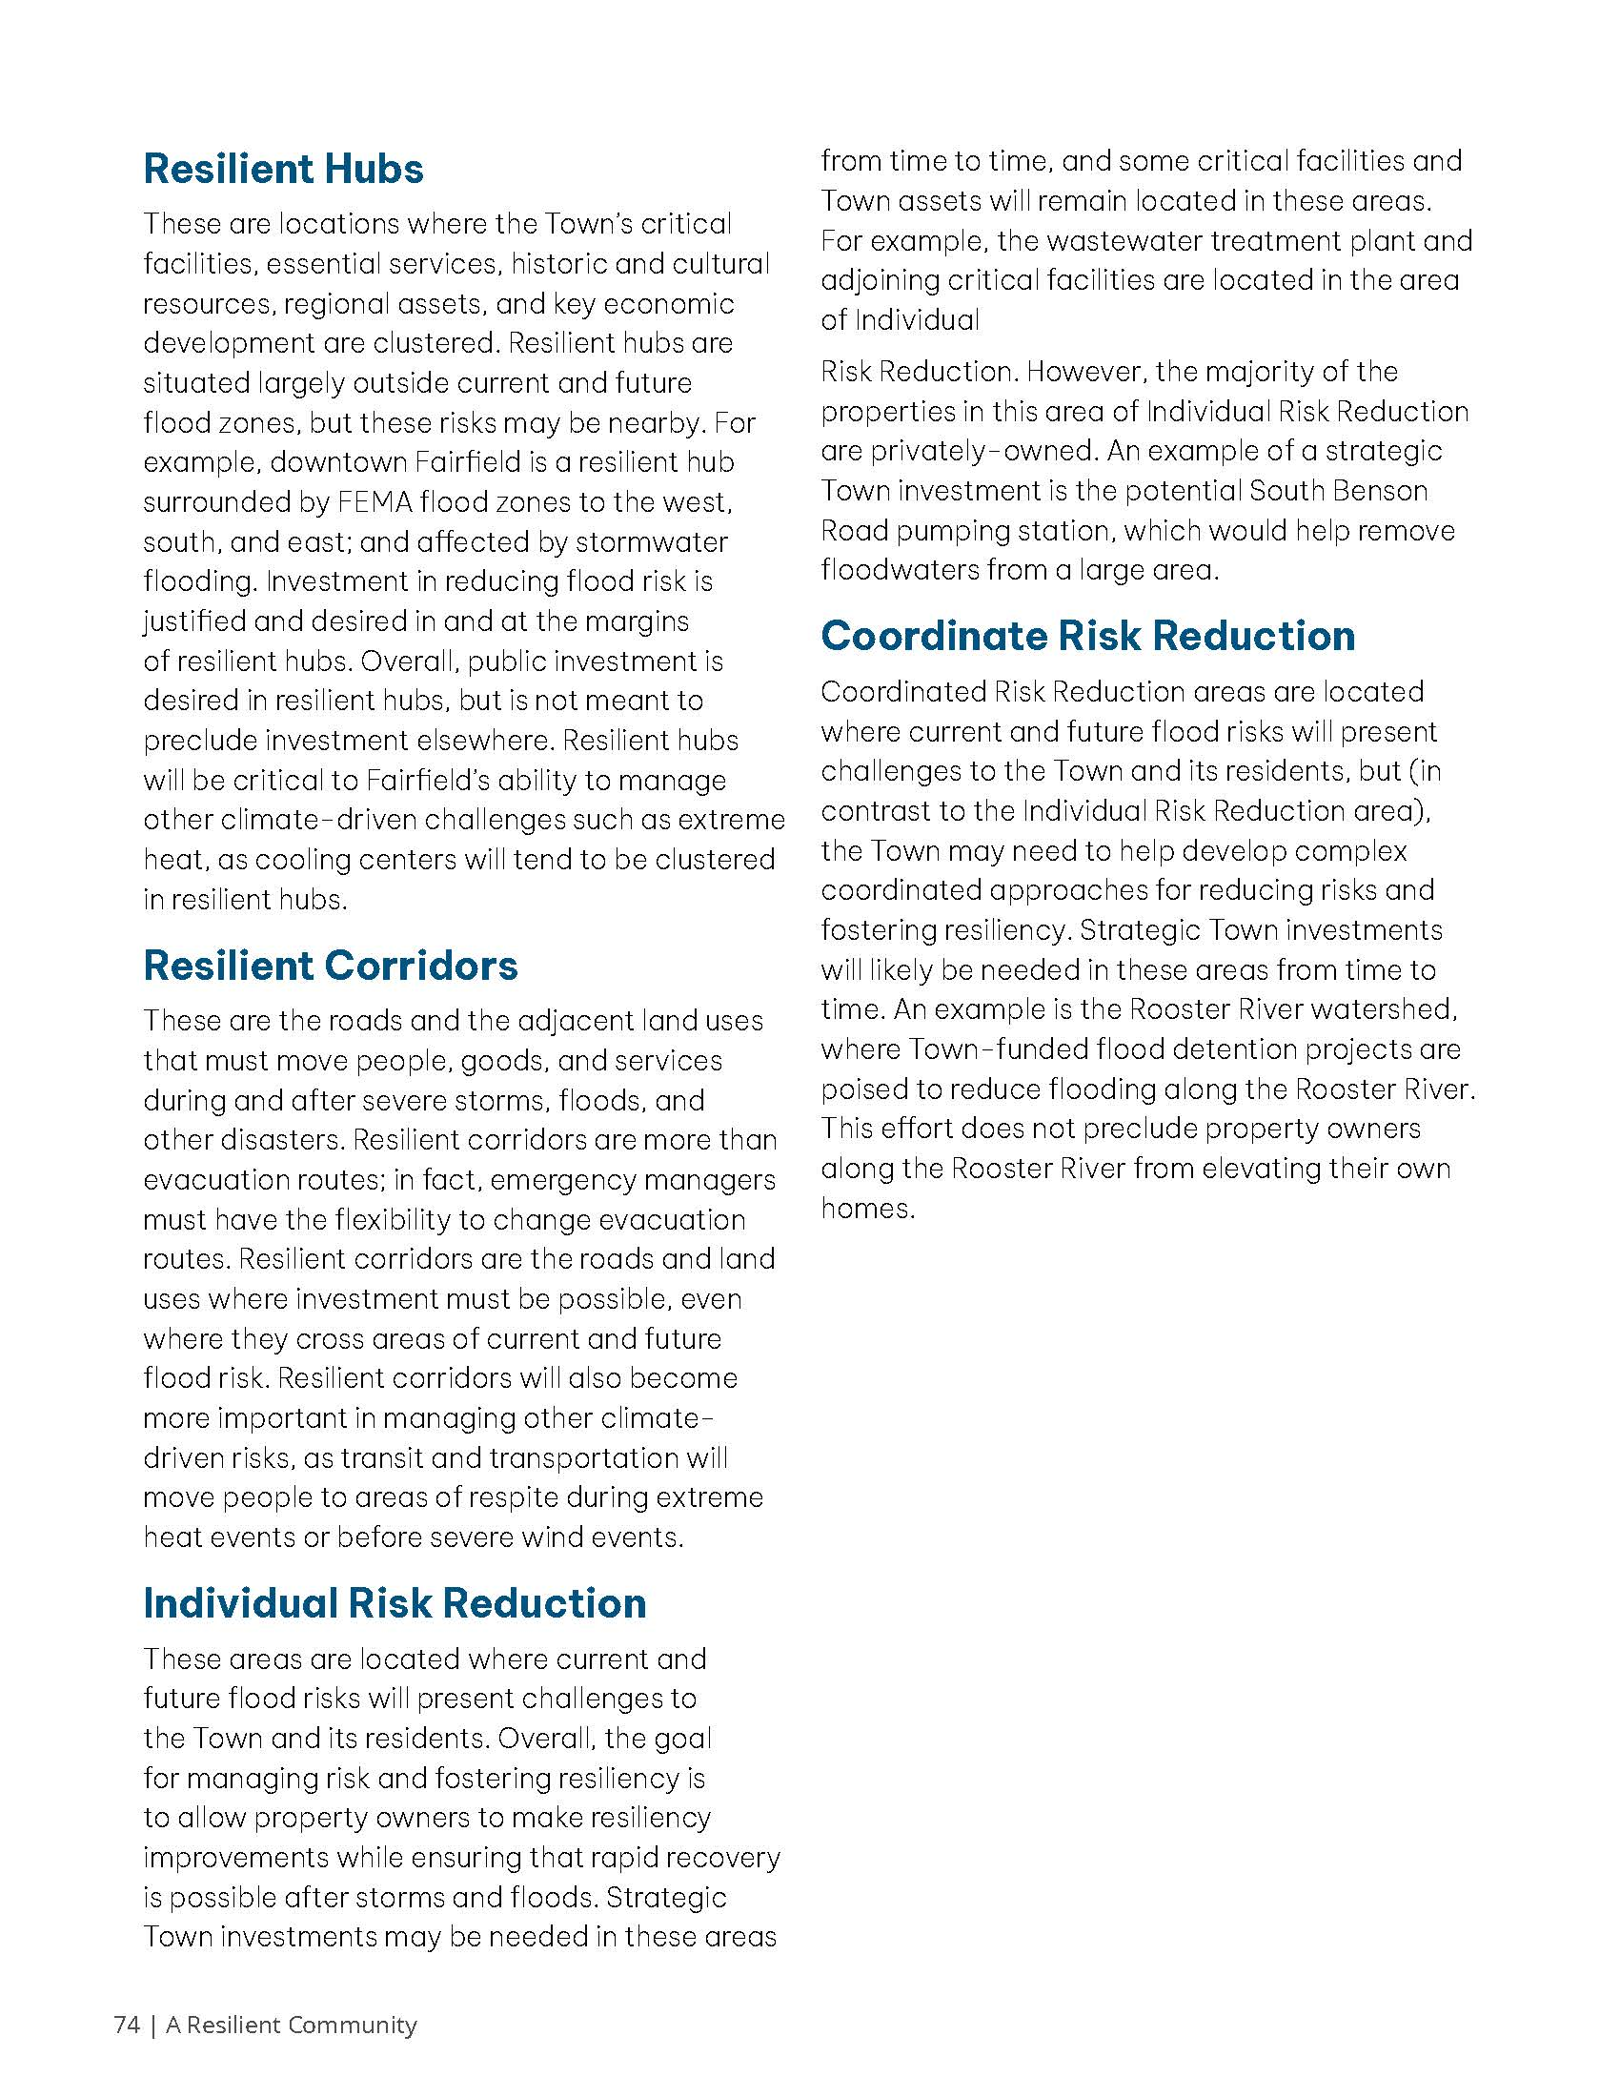
Early Implementation Examples
ADOPTED

Slide 60
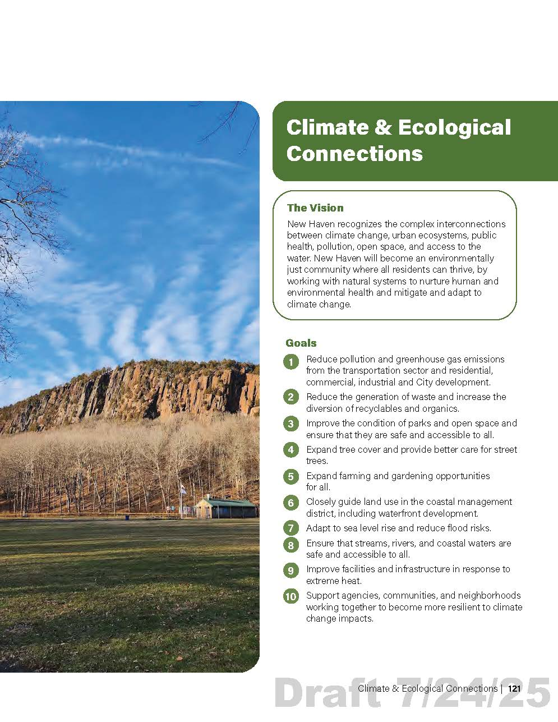
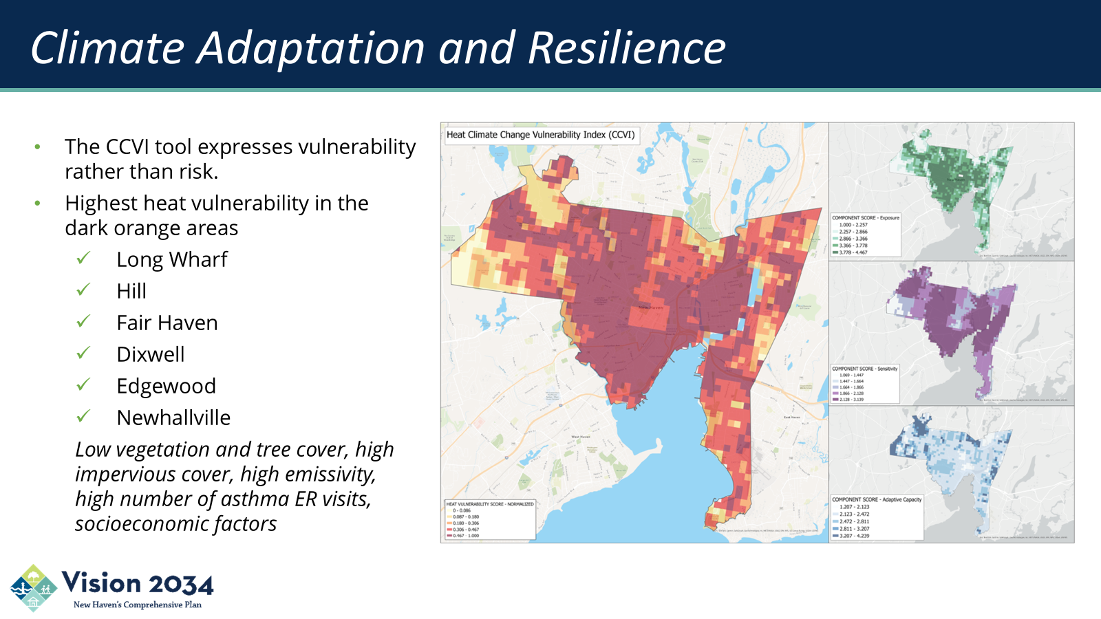
Early Implementation Examples
ADOPTED

Slide 61
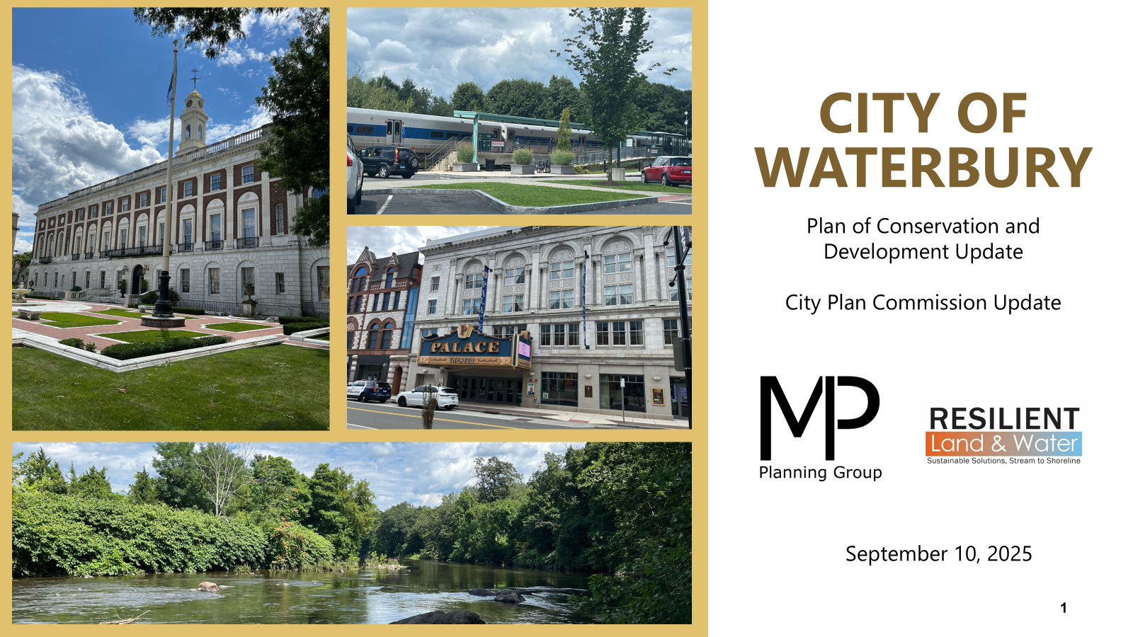
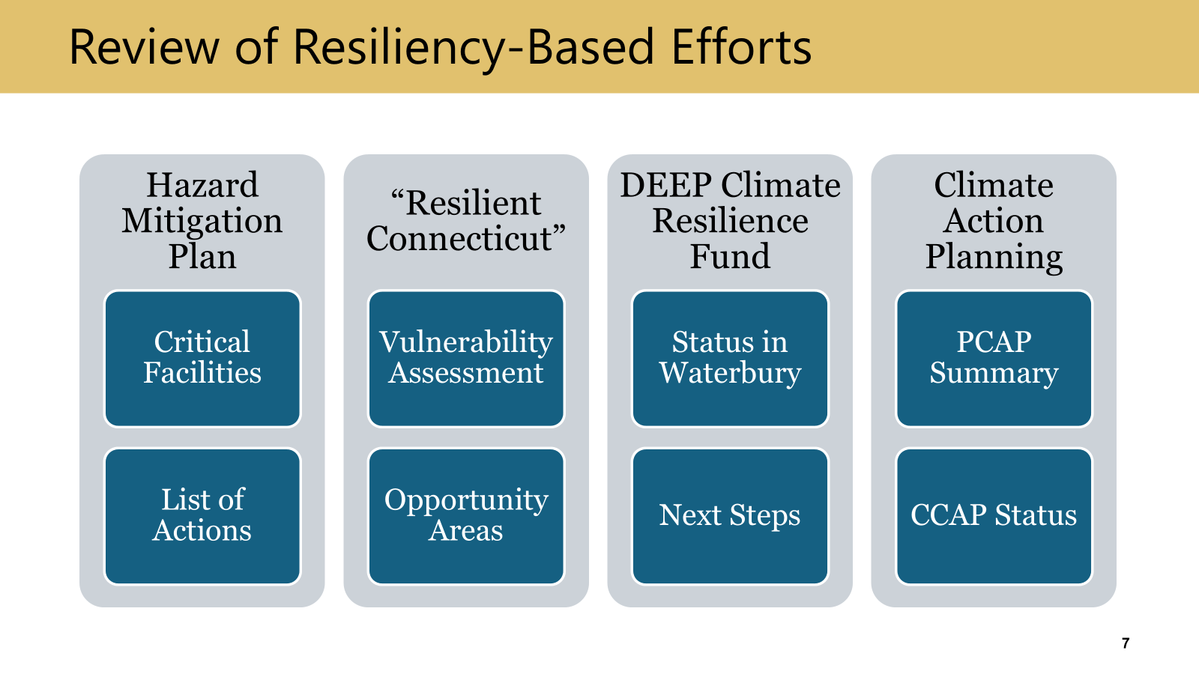
Early Implementation Examples
Planning Underway

Slide 62

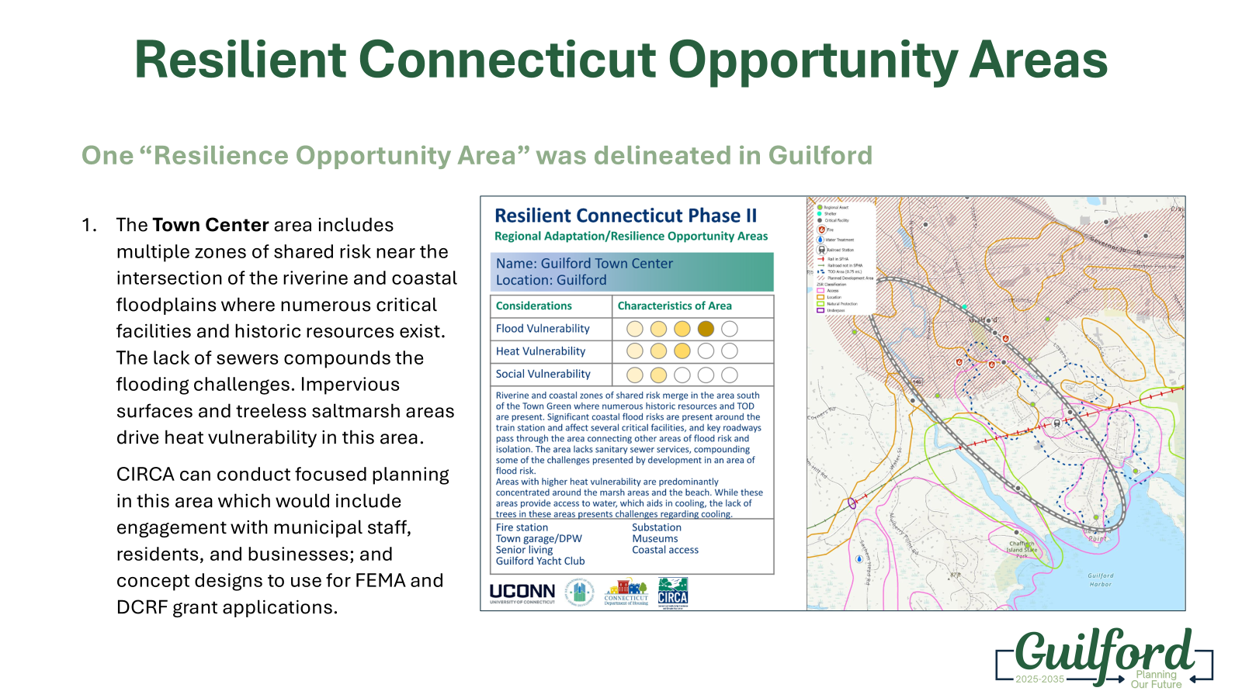
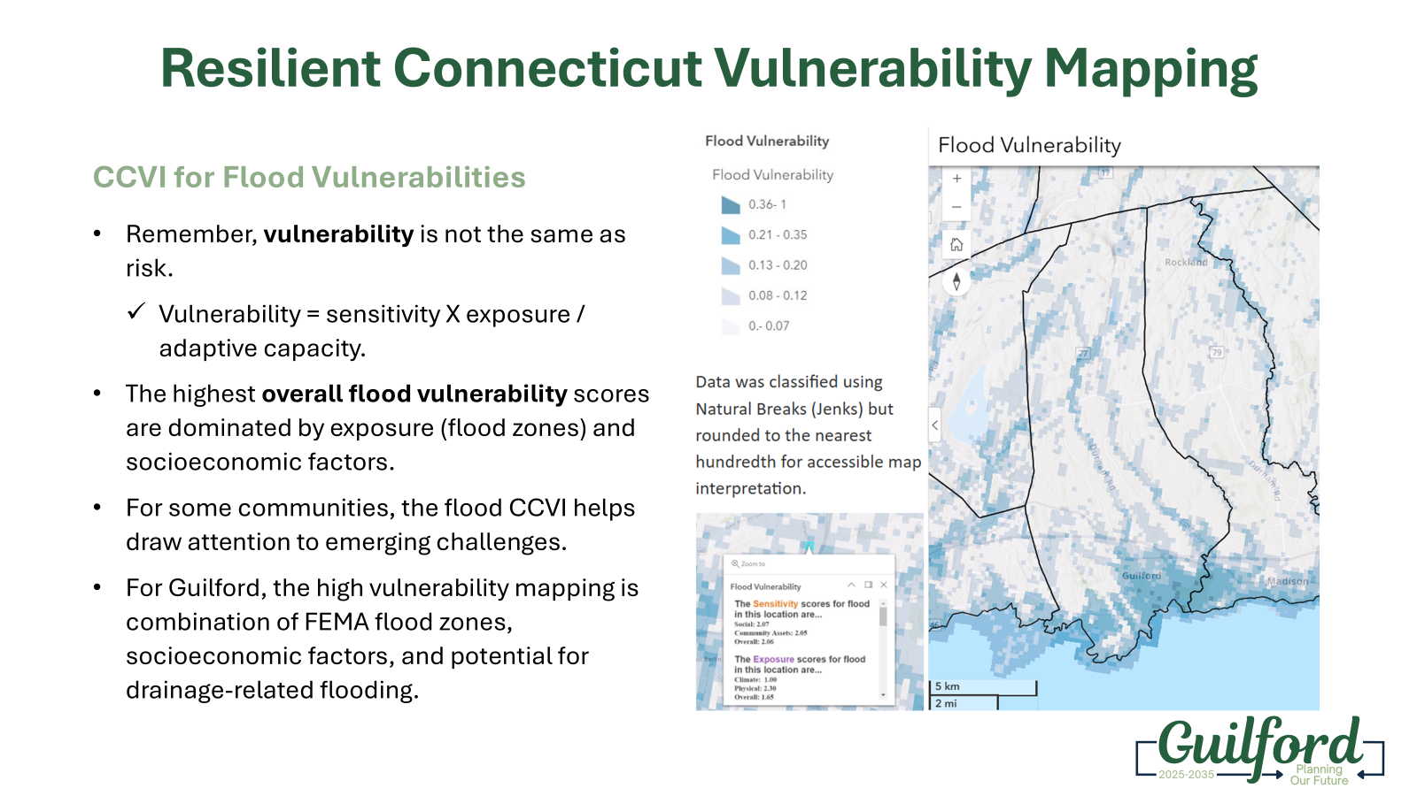
Early Implementation Examples
Planning Underway

Slide 63
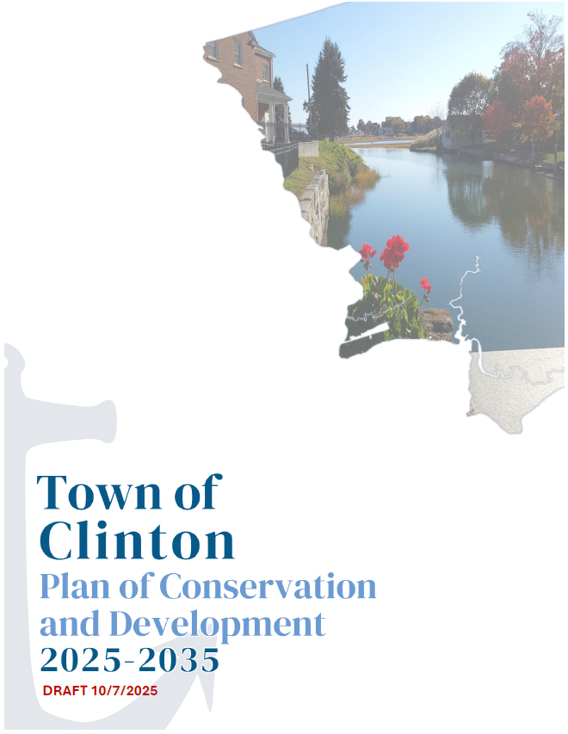
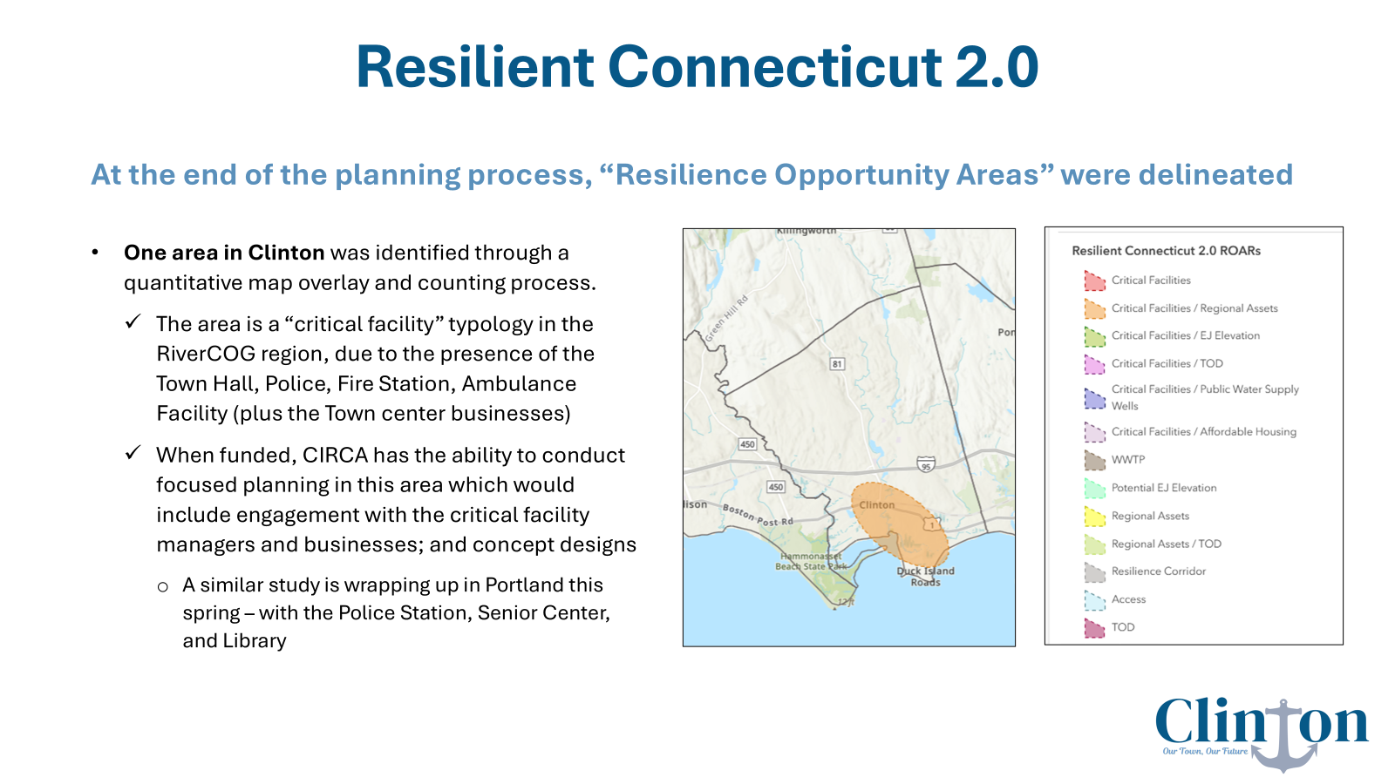
Early Implementation Examples

Slide 64

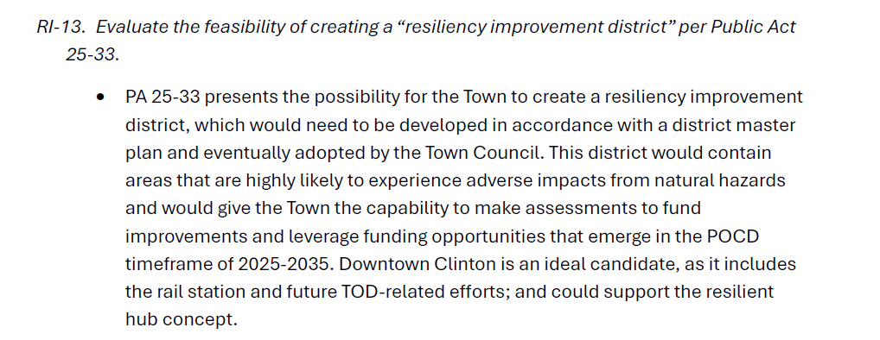
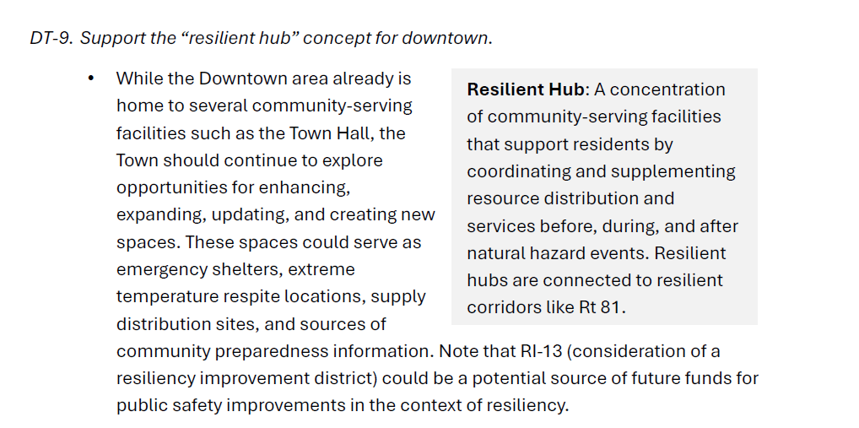
Early Implementation Examples
Locked for 65-Day Review by DEEP and COG

Slide 65
What’s Next For Small Towns?
Reach out to your COG planning staff and CIRCA to get help with your POCD if you do not use a consultant
  Look for ways to begin incorporating the new Statutes from 25-33
  Postpone what you must, but remember that POCDs starting in 2026 may not be done until 2027
Participate in your COG-driven hazard mitigation plan updates
  Reach out to DEMHS about this fall’s HMGP deadline
  Make sure DEEP Climate Resilience Fund applications are consistent with hazard mitigation plan actions
For NHCOG and NECCOG towns, watch for deployment of Resilient Connecticut 3.0

Slide 66
Thank you!
Questions/Comments
October 22, 2025
David Murphy, PE, CFM

