Slide 1
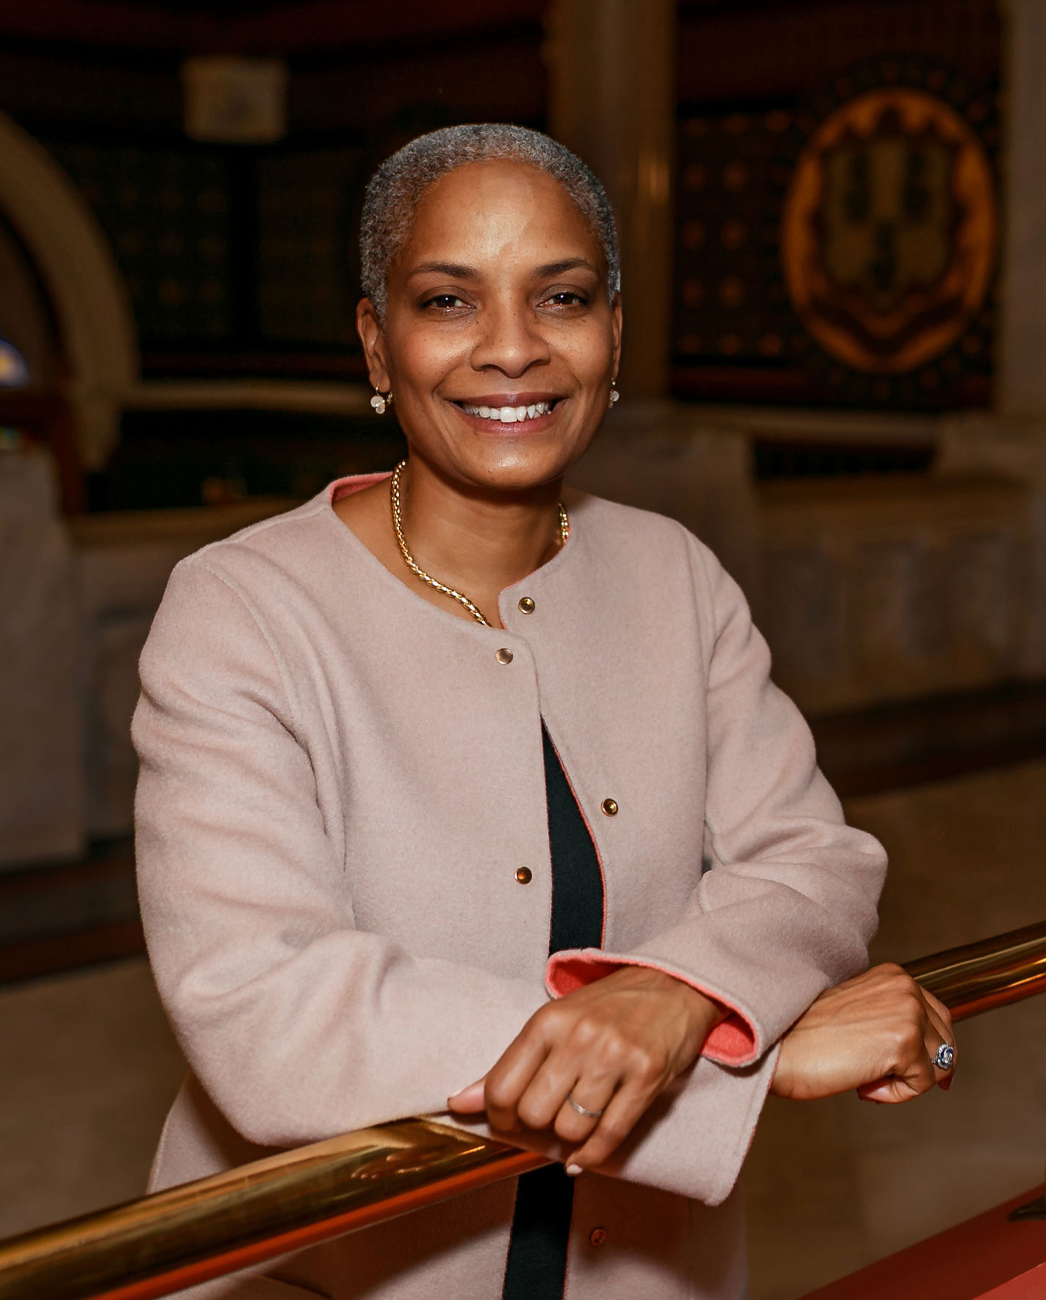
CT Council of
Small Towns
Office of the Connecticut Secretary of the State

Slide 2


Title
Change is the Only Constant
  New generation/new priorities
  Technological advances
  Global world/more risk (cybersecurity, foreign interference, artificial intelligence)
  Shift from local news outlets to national
  Tariffs and more!

Slide 3
Title
Agenda
  Early Voting
  Collaboration
  Future Landscape

Slide 4

1.76 million votes cast statewide
Early Voting
in 2024
740,000 early voters
40%
of the electorate
61%
60%
Salisbury
Madison

Slide 5
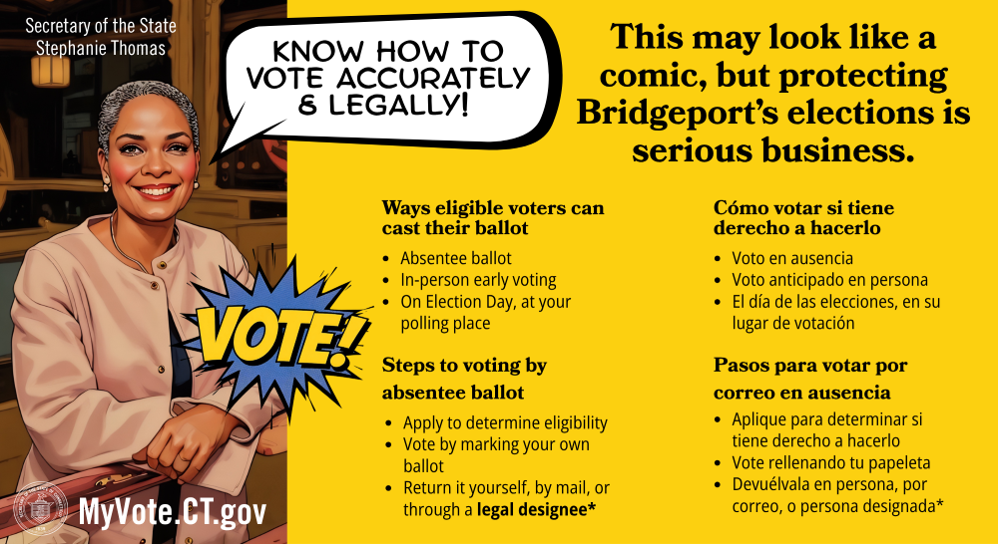
Title
Working Together
  Connecticut elections are a partnership
    Local, state, and federal entities working together.
  Learning from each other
    Listening and providing resources.

Slide 6
Title
Registrars Deserve a Raise!
  Early Voting
  Voting Tabulators
  Voter Registration System
  Election Management System
  Other laws

Slide 7
Title
Federal Initiatives
  SAVE Act – in Congress
  SAVE Program – run by USCIS
  DOJ Request for Voter Files
  DOJ Criminal Arm to Investigate
  Executive Order “Preserving Elections”

Slide 8
Title
Federal Cuts
  Help America Vote Act – $750,000 reduction
  Election Security Funding
  Cybersecurity Monitoring

Slide 9




How we Protect the Integrity of the Vote
Paper ballots
State-of-the-art tabulators
Chain of custody
Post-election audits
40%
of the electorate

Slide 10

Election Priorities
  Voter access
  All eligible voters can cast their ballot, without barriers.
  Security
  All stages of the system.
  Trust
  Voters must believe that their right to vote is protected and that the election is fair.
Office of the Connecticut Secretary of the State

Slide 11
Title
Open Door
  Keep us informed.
  Speak up about what works and what we need.
  Be proud of the work you do.

Slide 12


Thank You!
Follow us @CTSOTS on social media
Visit MyVote.ct.gov for all your election information

Slide 13


Slide 14
Insert
Picture / Chart]
Slide Title /
Subheader
Text

Slide 15
Title
Text

Slide 16
Title
Title

Slide 17

Text
Title
Text
Office of the Connecticut Secretary of the State

Slide 18
Insert
Text / Picture / Chart
Title

Slide 19
Title/Text
Text

Slide 20
Slide Title / Subheader
Text
Text
Text
Text
Office of the Connecticut Secretary of the State

Slide 21
Office of the Connecticut Secretary of the State

Slide 22






SOTS Branded Colors
Accent Colors
Blue
HEX#23408f
Light Blue
HEX#4078bd
Red
HEX#d2232a
White
HEX#ffffff
Orange
HEX#e76120
Yellow
HEX#e6b00f
Black
HEX#000000
Gray
HEX#595959
SOTS seals
SOTS Branded Fonts
Serif Fonts:
Verdana (default)
Trade Gothic (requires a license)
San Serif Font:
Clarendon
SOTS Branding Guidelines

Slide 23











VOTE LOCAL
CEO PLEDGE BADGE
Transparent Background
White
Background
VOTE EVERY NOVEMBER
BALLOT DROP BOX
VOTE = VOICE (color / B+W; stacked / 1-line)
No Ballot
with Ballot
Various SOTS Elements

Slide 24
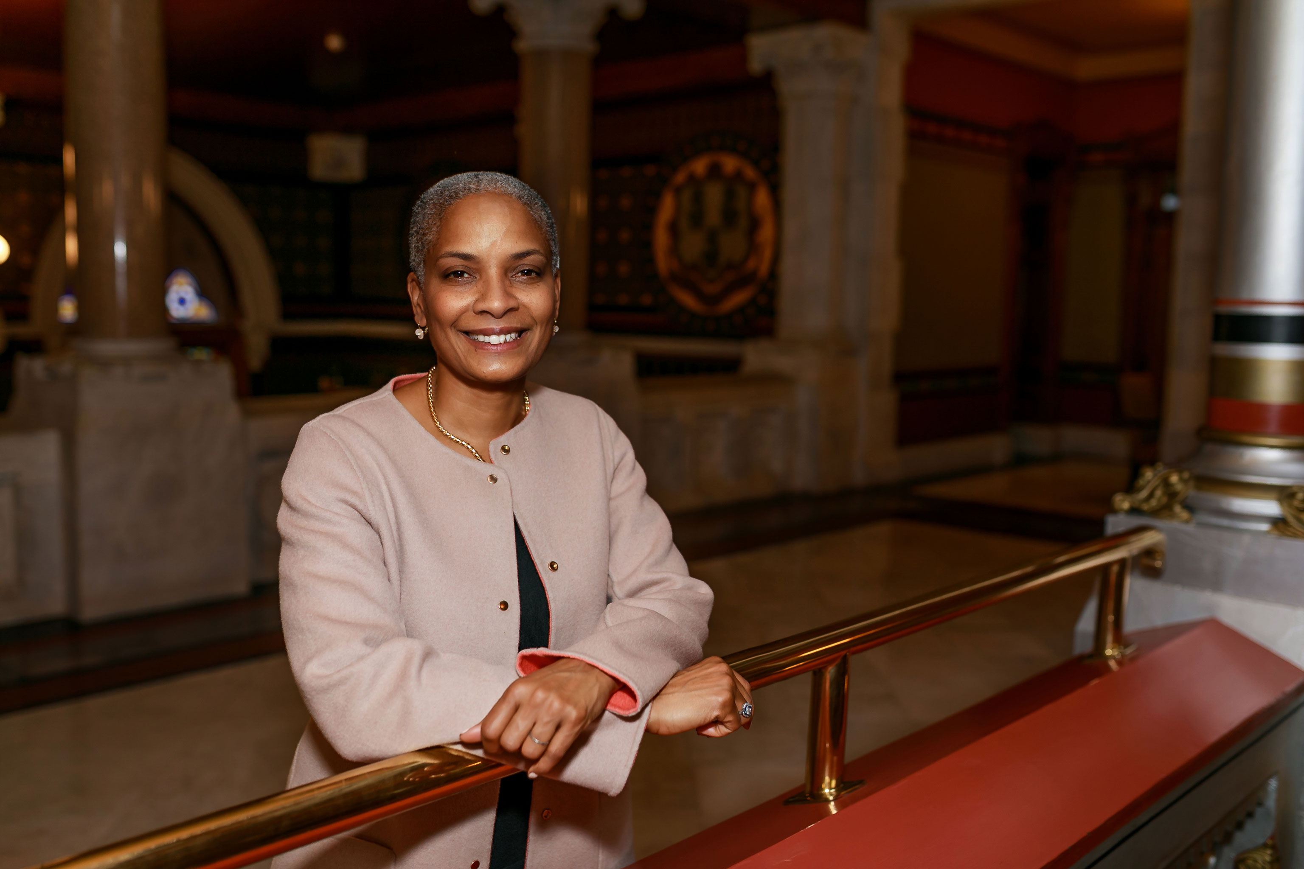

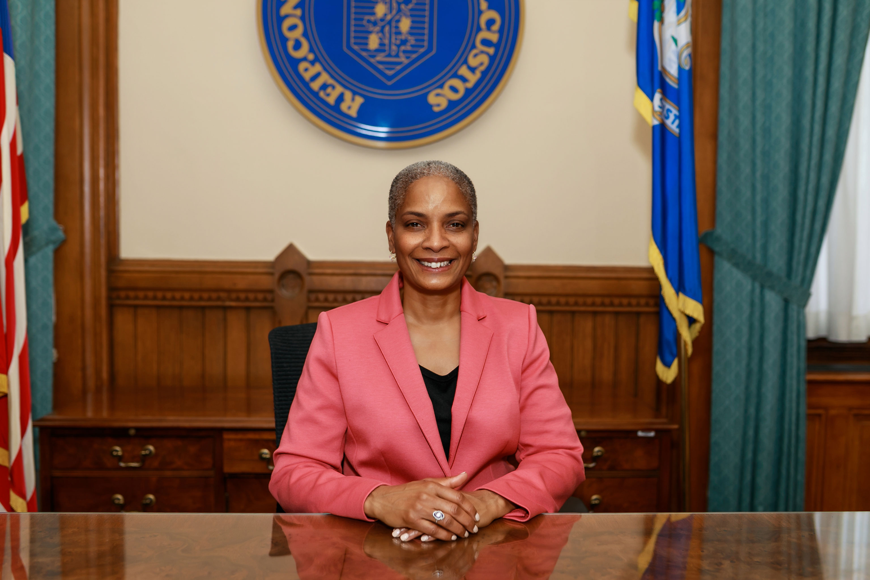
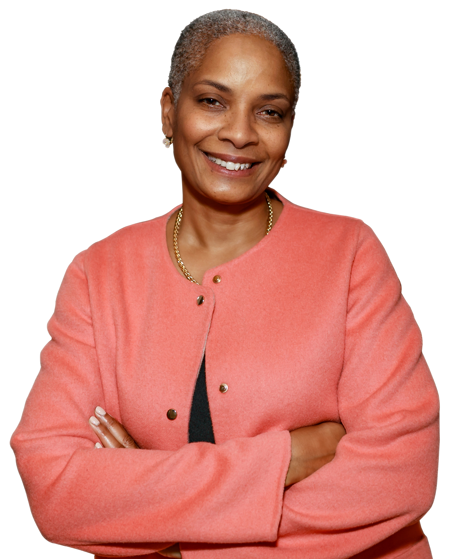
HEADSHOTS:
Secretary Stephanie Thomas
Deputy Secretary Jennifer D. Barahona

